Slide 2
The Three Woes
A Guide to Understanding Revelation and End Time Prophecies
Notes:
Welcome to “The Three Woes” Revelation Bible Study. Who is online? Where are you from? What would you like to learn from this study?
We have 40 minutes reserved with Zoom today. The PowerPoint presentation today will take about 20 minutes. During the course of the presentation, I will be asking some rhetorical and thought provoking questions. Please don’t try to answer them during the course of the presentation. Once we have reached the end of the presentation, we should have about 20 minutes to answer those and other questions. Meanwhile, if you expect to have noise in the background, I would like to ask you to mute your microphone at this time and then you can unmute it when we reach the discussion segment of this presentation.

Slide 3
Notes:
Revelation is one of the most difficult books of the Bible to understand. The first thing we should do, is to see if we can divide it into manageable sections. That is what we have done here. As we look at the bar at the top of this page you can see where we have separated Revelation into seven manageable sections. As we look at this division, we see that the first three and the last three sections become more understandable and manageable. That leaves us with the heart of Revelation, to decipher and understand. As we move forward in this study, you will see why we have called this heart of Revelation “The Seven Seals”. Mentioned Scriptures. Address the sections. What I have done here is quote a verse or partial verse from the beginning of each of the 7 sections that pretty much describes what that section is about.

Slide 4
Notes:
Read Note in Chart first. As we look at chapters five through eighteen, the common element of this section is the “The Seven Seals”. The problem is that this is not easy to recognize. As we look at the green bar in this chart it would be reasonable to question, why is the seventh seal shown so disproportionately larger than the other seals. The seventh seal begins at Rev. 8:1 and we are showing it going all the way to Revelation chapter 19. The description of each of the other seals continue only for two to six verses of the Bible and then it moves to the next seal. So why are we showing the seventh seal continuing on for ten chapters of Revelation? That is a good question and we will answer that in just a little bit. Another thing that we should note here is that there are no specified end times assigned to any of these seals. We didn’t just decide to leave the end points out, they are not provide to us in the scriptures. We should be asking ourselves, why are end times not provided?

Slide 5
Notes:
On this slide we are displaying the scripture verses that show where each seal begins. As we mentioned on the previous slide, the scriptures do not provided us with any obvious end points for any of the seals, not even the seventh seal. However, for some events in Revelation, we are given both a start time as well as an end time where the event is completed. We believe the reason and the purpose of this lack of any specific end times for any seal is that once a seal is opened, that seals impact on the world is ongoing until the return of Jesus. On this slide, we have chosen to provide an end time for the seventh seal. That end point is Revelation 18:24. We will show how we arrived at this end point a little later.

Slide 6
Notes:
The other take away that we should get from the seals is that they are being opened in sequential order. While we aren’t told this specifically, it is definitely implied.

Slide 7
Notes:
It seems logical and reasonable that the seals are being opened in sequential order, but it is always dangerous to assume anything. So, the question is, can we fine any scriptural proof that the seals are definitely being opened in sequential order.

Slide 8
Notes:
The answer to that is Yes, we can find scriptural proof that the seals are indeed being opened in sequential order and we will look at that next.

Slide 9
Notes:
As we jump over to Revelation chapter 8 verse 13, we find what appears to be a very short and simple little verse of scripture. Read the Scripture. But while this verse may be short, in reality, it is definitely not simple, it is packed with valuable information. In this verse, God talks about the three woes that are about to come upon the inhabitants of the earth. What is so easy to miss, is the importance of the connection between these three woes and the actions of three specific trumpet angels.

Slide 10
Notes:
As we begin to read in Revelation chapter 9, we can see why Rev. 8:13 is so important. Rev. 8:13 ties the fifth, sixth and seventh trumpet angels to the three woes. What we see in this slide is an account of when a trumpet angel sounds and when a woe is ended. We also see that the very next thing to occur is the sounding of the next trumpet angel which starts the next woe. What we should learn here is that these woes are sequential, just like the seals. The only difference is that the seals had no end time assigned to them because they were and are ongoing events. One other thing we should notice here is that we are not told when the third woe is past, instead in Rev. 16:17, we see the phrase “It is done”. The seventh angel has completed his work, but the impact of his sounding is not finished. We will explain the importance of this later. Point out the start and stops in the slide.

Slide 11
Notes:
It is believed that most Christians see Rev. chapters 5 – 18 as the seven years of Tribulation and based on their pre-trib, mid-trib, post-trib views, they place the rapture of the church somewhere between the beginning of Chapter 4 and the end of chapter 18.
On the next few slides, I will be asking some questions, but please hold your answers until the discussion segment.

Slide 12
Notes:
Is this how you view chapters 5 -18?

Slide 13
Notes:
Does anyone see chapters 5 – 18 differently?

Slide 14
Notes:
Does anyone know why thinking that chapters 5 – 18 as the 7 years of tribulation is a problem?

Slide 15
Notes:
The problem with this concept is that the scriptures define a time span of seven years and five months from Rev. 9:1 to Rev. 16:17.

Slide 16
Notes:
Does anyone know how we can prove this statement scripturally?

Slide 17
Notes:
We hinted to the answer to that question earlier when we mentioned the three woes.

Slide 18
Notes:
NOTE! For the sake of space, we have paraphrased some of these scriptures on this slide. You can look them up and verify the accuracy of the statements following the class.
Let’s look at the first woe.
As we examine the scriptures, we can see where the fifth trumpet angel sounds in Rev. 9:1 and we can see where that angels woe is past in Rev. 9:12. What we then see is a five month time span of activity assigned to the impact of the fifth trumpet angel and the first woe.

Slide 19
Notes:
As we continue our examination, we can see several time spans assigned to the sixth trumpet angel and the second woe. As we look at the first of these time frames, The KJV is a little confusing where it says “for an hour, and a day, and a month and a year” but Young’s Literal Translation says “Who have been made ready for the hour, and day and month and year”. This is a war that starts at a specific point in time during this angels sounding. The forty two months and the 1,260 day time spans that we see next are equal lengths of time. They both equal three and one half years. These two events will run concurrently along with the war that slays a third part of men.

Slide 20
Notes:
As we conclude our examination of the three woes, we see three events that are assigned to the seventh trumpet angel and the third woe. The events are 1,260 days, the time, times and half a time and forty two months. These are all equal lengths of time and they are each three and one half years that will run concurrent with each other. As we review, looking at all three woes, we see that the total time span for all three woes is 7 years and 5 months! That is quite a difference from our original concept that chapters 5 - 18 is 7 years. The second and third woes appear to be the seven years of Jacob’s trouble, the seven years of Tribulation. That raises the issue of where do we fit in Rev. 5:1 through Rev. 9:13. NOTE: “It is done.” We will discuss this in just a moment.

Slide 21
Notes:
Just for reference, thus far, all of the material we have been studying was taken from the second chapter of the book, “The Three Woes: A Guide to Understanding Revelation and End Time Prophecies”. The charts we have been looking at so far are not in the book.

Slide 22
Notes:
But, The charts we are about to look at are in “The Three Woes” along with several other charts.
I’m sure you probably have questions at this point, but let’s look at just a couple of more slides and then we will have discussion time.

Slide 23
Notes:
This is one of the main charts in “The Three Woes”. All of the earlier Revelation charts that we have been looking at were derived from this chart. As the chart shows, the seven trumpet judgments are part of the results of the seventh seal. Furthermore, the seven vial/bowl judgments are part of the Seventh Trumpet Judgment. This is where and how we are now able to arrive at Rev. 18:24 as the end point of each of the seven seals. As you can see Daniel’s Seventieth Week, the Seven Years of Tribulation are equivalent to the sixth and seventh Trumpet Judgments. We will see that more clearly on the next slide. Rev. 16:17 states It is Done, this completes the seventh trumpet Judgment but the Vial/Bowl Judgments that are kicked off within the seventh Trumpet Judgment continue on so that the impact of the seven Vial Bowl Judgments and the seventh seal are ongoing until Rev. 18:24. Seven Thunders (don’t mention) There is a lot on this chart, and I am sure there are questions, but let’s look at just one more chart before we go to discussion time.

Slide 24
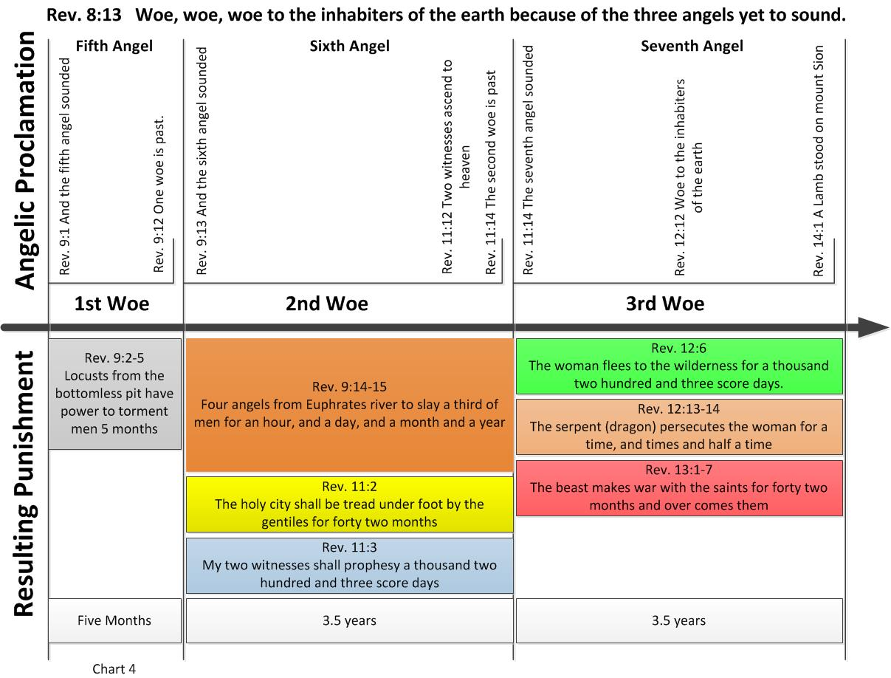
Notes:
On this slide, we can see the three woes expanded out in more detail. Together the second and third woe are the Seven Years of Jacob’s Trouble or as most of us would call it, The Great Tribulation. It becomes clear that the second woe is the first half of the great Tribulation, and the third woe is the second half of the great Tribulation. In the book “The Three Woes” we delve into this in a far greater extent than our time here will permit. And again, I’m sure there are questions?

Slide 25
Notes:
On this slide, we see Daniel’s Seventieth Week. For the first 3.5 years, God’s Two Witnesses are ministering and the Antichrist is on the scene but his activities are concealed. At the middle of the seven years, the Antichrist desecrates the Third Temple and is probably the murderer of the Two Witnesses. During the last 3.5 years of Daniel’s Seventieth week, the Antichrist and the False Prophet with the power of the devil will help bring the true horrors of the wrath of God upon the inhabitants of the earth. During the last half of the Tribulation period the Antichrist’s true nature will be revealed.

Slide 26
Notes:
That pretty much covers all of our material on this introduction to Understanding Revelation. So let’s go to Discussion Time!
Don’t forget to unmute your microphone or we won’t be able to hear you.
Slide 11, 12 &13 Questions: How did you view Rev. chapters 5 – 18? Did you see it as the 7 years of Tribulation?
Did anyone view chapters 5 – 18 differently?
Was anyone aware of the time frames hidden within the three woes?

Slide 27
Notes:
If you would like to learn more about Revelations time line we would like to invite you to get a copy of “The Three Woes”. Not only will you learn more about Revelation’s time lines and the three woes, you will also learn about the significance of the Cosmic Signs, the timing of Ezekiel’s War, the fulfillment of God’s Prophetic Feast Days, and what the Seven Sealed Book of Revelation is all about. Read a chapter a day for daily devotions or use it as a study guide for a Sunday School Class or a Bible Study. “The Three Woes” is available online only, it is not currently in retail bookstores, you can get it through Amazon, Barnes and Noble or Books-A-Million. Also, visit us at our WEB site www.3woes.com and on Facebook at: 3woes Thank you for your time and interest in Revelation.

