Slide 2
The Three Woes
A Guide to Understanding Revelation and End Time Prophecies
Bible Study
Day 1 - Discovering Revelation’s T imeline & Are We Living in the End Times?
Chapters 1 thru 4
Day 2 - Understanding Revelation’s Mysteries & God's Assigned Feast Days
Chapters 5 thru 7
Day 3 - Post End Time Prophecies & The Rapture of the Church
Chapters 8 thru 11 and Bonus Material on the Rapture
Copyright © 2020 by Barney Rapp
Notes:
On our first day of the Bible Study, we are going to discover the hidden Timeline that is within the Book of Revelation and examine how to apply it to our study and understanding of the Book of Revelation. Following that, we are going to look at a number of other End Time prophecies to see if we can determine just where we are in relation to God’s calendar of End Time events.

Slide 3
The secret to understanding the Book of Revelation is recognizing and understanding the time line clues found in the book of Revelation.
Copyright © 2020 by Barney Rapp

Slide 4
In Genesis, God gives many us many dates and time lines in the form of generational begats. We can learn much if we are willing to take the time to study what is there.
Copyright © 2020 by Barney Rapp
Notes:
Most of us are pretty familiar with all the ‘begats’ in Genesis. The word ‘begat’ occurs 71 times in the Pentateuch and 67 of those are in Genesis. The phrase ‘son of’ occurs 171 times in the Pentateuch. Most of the time I think we look at these and consider it boring reading, but if we will take the time to study some of these it can lead to a very informative study.

Slide 5
A great example of this is Adam, Adam's grandson Enos and Noah.
We don't typically think much about it, but Adam's grandson Enos was born when Adam was 235 years old. So Enos knew his grandfather for almost 700 years before Adam died. Noah was born 84 years before Enos died. That's a lifetime to us in our age. Imagine the history that Enos could have shared with Noah about Adam and Eve and their life in the Garden of Eden and their life after they were cast out of the Garden of Eden.
Copyright © 2020 by Barney Rapp
Notes:
A great example of this is Adam’s grandson, Enos. Adam was 235 years old when Enos was born, so Enos knew Adam for almost 700 years before Adam died. Noah was born 84 years before Enos died. That equates to a lifetime in our age. Can you imagine the history and the stories about Adam and Eve that Enos could have shared with Noah? I am a grandfather now and I remember all the stories that my grandfather would share with me when I was a teenager.

Slide 6
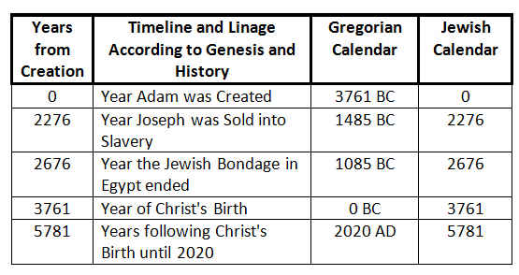
Another great example from Genesis is found when you trace the generational lineages from Adam to Joseph. If we accept 1085 BC as the date of the Exodus, then our current year would match the current year on the Jewish Calendar.
Copyright © 2020 by Barney Rapp
Notes:
Secular history places the Exodus somewhere between 500 BC and 1300 BC. If you take the year 1085 BC as the year of the Exodus, then a very amazing correlation appears between the Jewish calendar and our Gregorian calendar.

Slide 7
You might be thinking, So what?
But,
This does two things, one, it supports the historic estimate of when the Jewish Exodus occurred and it supports the accuracy of the Jewish calendar. It also refutes the concept that man has been on the earth for millions of years.
Copyright © 2020 by Barney Rapp
Notes:
So, maybe you’re thinking “So what”. Well, this does two things. It supports the historic estimate of when the Jewish Exodus occurred and it supports the accuracy of the Jewish calendar. It also refutes the concept that man has been on earth for millions of years. It establishes that man has been on earth for approximately 6,000 years. 5,781 exactly.

Slide 8
So, can we follow the timeline clues in Revelation as we did in Genesis? Well, yes and no. Genesis is like walking down a dry creek bed and finding golden nuggets all over the place. All you need to do is reach down and pick them up. Revelation is more like using a pick and shovel to dig through a mountain side. The nuggets are there but you have to work to get to them. So, let's prepare ourselves to start digging in the book of Revelation.
Copyright © 2020 by Barney Rapp
Notes:
We started our study of Revelation in Genesis so we could establish the importance of the dates and timelines that the Bible gives us. So, can we follow the timeline clues in Revelation like we did in Genesis? Well, yes and no. Genesis is like walking down a dry creek bed and finding golden nuggets all over the place. All you need to do is reach down and pick them up. Revelation is more like using a pick and shovel to dig through a mountain side. The golden nuggets are there but you have to work to get to them. So let’s start mining some golden nuggets.

Slide 9
The ability to understand the Book of Revelation can be greatly affected by how we approach the book. If we approach the reading of the Book of Revelation with a prayerful attitude, an open heart and an open mind, believing that it is God's Word given to us by Devine inspiration through John, then there is much we can learn.
Copyright © 2020 by Barney Rapp
Notes:
Read the above slide. Notice that Open Mind is highlighted. Frequently what we have been taught in the past becomes the most difficult obstacle to understanding Revelation. I frequently have the opportunity to speak with individuals and they will tell me, ‘I see your point, but what about this’? And, their ‘this’ will be some insignificant issue or idea from their past that is keeping them from accepting and adopting the new truth that they admit that they can plainly see. Example: Martyrs under the altar, under the altar meant something to the individual that made them think these martyrs had to be from the time of the mark of the beast when people were being beheaded.

Slide 10
Notes:
Revelation is one of the most difficult books of the Bible to understand. The first thing we should do, is to see if we can divide it into manageable sections. That is what we have done here. As we look at the bar at the top of this page you can see where we have separated Revelation into seven manageable sections. As we look at this division, we see that the first three and the last three sections become more manageable and understandable. That leaves us with the heart of Revelation, to decipher and understand. As we move forward in this study, you will see why we have called this heart of Revelation “The Seven Seals”. Mentioned Scriptures. Address the sections. What I have done here is quote a verse or partial verse from the beginning of each of the 7 sections that pretty much describes what that section is about.

Slide 11
Notes:
Read Note in Chart first. As we look at chapters five through eighteen, the common element of this section is the “The Seven Seals”. The problem is that this is not easy to recognize. As we look at the green bar in this chart it would be reasonable to question, why is the seventh seal shown so disproportionately larger than the other seals. The seventh seal begins at Rev. 8:1 and we are showing it going all the way to Revelation chapter 19. The description of each of the other seals continue only for two to six verses of the Bible and then it moves to the next seal. So why are we showing the seventh seal continuing on for ten chapters of Revelation? That is a good question and we will answer that in just a little bit. Another thing that we should note here is that there are no specified end times assigned to any of these seals. We didn’t just decide to leave the end points out, they are not provide to us in the scriptures. We should be asking ourselves why are end times not provided?

Slide 12
Notes:
On this slide we are displaying the scripture verses that show where each seal begins. As we mentioned on the previous slide, the scriptures do not provided us with any obvious end points for any of the seals, not even the seventh seal. However, for some events in Revelation, we are given both a start time as well as an end time where the event is completed. We believe the reason and the purpose of this lack of a specific end times for any seal is that once a seal is opened, that seals impact on the world is ongoing until the return of Jesus. On this slide, we have chosen to provide an end time for the seventh seal. That end point is Revelation 18:24. We will show how we arrived at this end point a little later. Read the scripture verses above.

Slide 13
Notes:
The other take away that we should get from the seals is that they are being opened in sequential order. While we aren’t told this specifically, it is definitely implied.

Slide 14
Notes:
It seems logical and reasonable that the seals are being opened in sequential order, but it is always dangerous to assume anything. So, the question is, can we fine any scriptural proof that the seals are definitely being opened in sequential order.

Slide 15
Notes:
The answer to that is Yes, we can find scriptural proof that the seals are indeed being opened in sequential order and we will look at that next.

Slide 16
Notes:
As we jump over to Revelation chapter 8 verse 13, we find what appears to be a very short and simple little verse of scripture. Read the Scripture. But while this verse may be short, in reality, it is definitely not simple, it is packed with valuable information. In this verse, God talks about the three woes that are about to come upon the inhabitants of the earth. What is so easy to miss, is the importance of the connection between these three woes and the actions of three specific trumpet angels.

Slide 17
Notes:
As we begin to read in Revelation chapter 9, we can see why Rev. 8:13 is so important. Rev. 8:13 ties the fifth, sixth and seventh trumpet angels to the three woes. What we see in this slide is an account of when a trumpet angel sounds and when a woe is ended. We also see that the very next thing to occur is the sounding of the next trumpet angel which starts the next woe. What we should learn here is that these woes are sequential, just like the seals. The only difference is that the seals had no end time assigned to them because they were and are ongoing events. One other thing we should notice here is that we are not told when the third woe is past, instead in Rev. 16:17, we see the phrase “It is done”. The seventh angel has completed his work, but the impact of his sounding is not finished. We will explain the importance of this later. Point out the start and stops in the slide.

Slide 18
Notes:
It is believed that most Christians see Rev. chapters 5 – 18 as the seven years of Tribulation and based on their pre-trib, mid-trib, post-trib views, they place the rapture of the church somewhere between the beginning of Chapter 4 and the end of chapter 18.
On the next few slides, I will be asking some questions, but please hold your answers until the discussion segment.

Slide 19
Notes:
Is this how you view chapters 5 -18?

Slide 20
Notes:
Does anyone see chapters 5 – 18 differently?

Slide 21
Notes:
Does anyone know why thinking that chapters 5 – 18 as the 7 years of tribulation is a problem?

Slide 22
Notes:
The problem with this concept is that the scriptures define a time span of seven years and five months from Rev. 9:1 to Rev. 16:17.

Slide 23
Notes:
Does anyone know how we can prove this statement scripturally?

Slide 24
Notes:
We hinted to the answer to that question earlier when we mentioned the three woes.

Slide 25
Notes:
NOTE! For the sake of space, we have paraphrased some of these scriptures on this slide. You can look them up and verify the accuracy of the statements following the class.
Let’s look at the first woe.
As we examine the scriptures, we can see where the fifth trumpet angel sounds in Rev. 9:1 and we can see where that angels woe is past in Rev. 9:12. What we then see is a five month time span of activity assigned to the impact of the fifth trumpet angel and the first woe.

Slide 26
Notes:
As we continue our examination, we can see several time spans assigned to the sixth trumpet angel and the second woe. As we look at the first of these time frames, The KJV is a little confusing where it says “for an hour, and a day, and a month and a year” but Young’s Literal Translation says “Who have been made ready for the hour, and day and month and year”. This is a war that starts at a specific point in time during this angels sounding. The forty two months and the 1,260 day time spans that we see next are equal lengths of time. They both equal three and one half years. These two events will run concurrently along with the war that slays a third part of men.

Slide 27
Notes:
As we conclude our examination of the three woes, we see three events that are assigned to the seventh trumpet angel and the third woe. The events are 1,260 days, the time, times and half a time and forty two months. These are all equal lengths of time and they are each three and one half years that will run concurrent with each other. As we review, looking at all three woes, we see that the total time span for all three woes is 7 years and 5 months! That is quite a difference from our original concept that chapters 5 -18 is 7 years. The second and third woes appear to be the seven years of Jacob’s trouble, the seven years of Tribulation. That raises the issue of where do we fit in Rev. 5:1 through Rev. 9:13. NOTE: “It is done.” We will discuss this in just a moment.

Slide 28
Notes:
Just for reference, thus far, all of the material we have been studying was taken from the first and second chapter of the book, “The Three Woes: A Guide to Understanding Revelation and End Time Prophecies”. The charts we have been looking at so far are not in the book, but the charts that we are about to look at, are in the book.

Slide 29
Notes:
This is one of the main charts in “The Three Woes”. All of the earlier Revelation charts that we have been looking at were derived from this chart. As the chart shows, the seven trumpet judgments are part of the results of the seventh seal. Furthermore, the seven vial/bowl judgments are part of the Seventh Trumpet Judgment. This is where and how we are now able to arrive at Rev. 18:24 as the end point of each of the seven seals. As you can see Daniel’s Seventieth Week, the Seven Years of Tribulation are equivalent to the sixth and seventh Trumpet Judgments. We will see that more clearly on the next slide. Rev. 16:17 states 'It is Done', this completes the seventh trumpet Judgment but the Vial/Bowl Judgments that are kicked off within the seventh Trumpet Judgment continue on so that the impact of the seven Vial Bowl Judgments and the seventh seal are ongoing until Rev. 18:24. Seven Thunders (don’t mention) There is a lot on this chart, are there any questions?

Slide 30
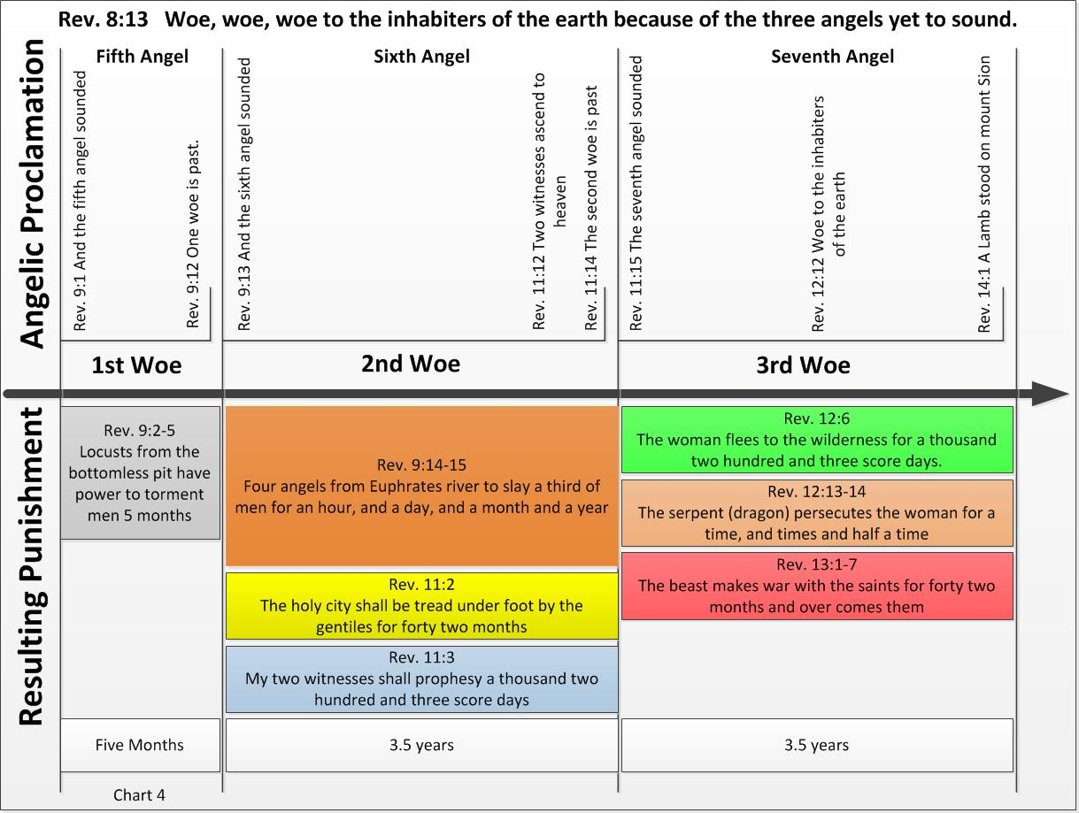
Notes:
On this slide, we can see the three woes expanded out in more detail. Together the second and third woe are the Seven Years of Jacob’s Trouble or as most of us would call it, The Great Tribulation. It becomes clear that the second woe is the first half of the great Tribulation, and the third woe is the second half of the great Tribulation. In the book “The Three Woes” we delve into this in a far greater extent than our time here will permit. Are there any questions here?

Slide 31
Notes:
On this slide, we see Daniel’s Seventieth Week. For the first 3.5 years, God’s Two Witnesses are ministering to Israel and the Antichrist is on the scene but his activities are concealed. At the middle of the seven years, the Antichrist desecrates the Third Temple and is probably the murderer of the Two Witnesses. During the last 3.5 years of Daniel’s Seventieth week, the Antichrist and the False Prophet with the power of the devil will help bring the true horrors of the wrath of God upon the inhabitants of the earth. During the last half of the Tribulation period the Antichrist’s true nature will be revealed.

Slide 32
At this point in our study of Revelation, we should be questioning just where are in God's prophetic timeline?
Most of us have pictured Revelation chapters 5 through 18 as the 7 years of Tribulation. Now that we know that the 7 years of Tribulation does not begin until Revelation 9:13, we need to seriously examine where we are on God's prophetic timeline.
To help us do that let’s look at some other prophecies.
Copyright © 2020 by Barney Rapp
Notes:
Read this slide.

Slide 33
Keep not thou silence, O God: hold not thy peace, and be not still, O God. For, lo, thine enemies make a tumult: and they that hate thee have lifted up the head. They have taken crafty counsel against thy people, and consulted against thy hidden ones. They have said, Come, and let us cut them off from being a nation; that the name of Israel may be no more in remembrance.
Psalm 83:1-4 KJV
Since 1965 until now various leaders from numerous Arab states have been making threats such as this against the state of Israel.
Copyright © 2020 by Barney Rapp
Notes:
Read the scripture above. For the past 55 years various Arab leaders have been making repeated threats against the state of Israel, so this particular prophecy has been fulfilled over and over for the past 55 years.

Slide 34
And I will set the Egyptians against the Egyptians: and they shall fight every one against his brother, and every one against his neighbour; city against city, and kingdom against kingdom. And the spirit of Egypt shall fail in the midst thereof; and I will destroy the counsel thereof: and they shall seek to the idols, and to the charmers, and to them that have familiar spirits, and to the wizards.
Isaiah 19:2-3 KJV
This appears to have been fulfilled with the conflict between the Egyptian government and the Muslim Brotherhood that ran from 1928 until 2011.
Copyright © 2020 by Barney Rapp
Notes:
Read the scripture above. This prophecy appears to have been fulfilled in 2011. It took over 80 years for the Muslim Brotherhood to finally gain political control of Egypt.

Slide 35
And the Egyptians will I give over into the hand of a cruel lord; and a fierce king shall rule over them, saith the Lord, the Lord of hosts.
Isaiah 19:4 KJV
In 2011, Mohamed Morsi, a member of the Muslim Brotherhood became president of Egypt until his overthrow in 2013.
Copyright © 2020 by Barney Rapp
Notes:
Read the scripture above. Mohamed Morsi’s rule was short lived because he was such a cruel leader. The people of Egypt rose up and overthrew him in 2013.

Slide 36
And the waters shall fail from the sea, and the river shall be wasted and dried up. And they shall turn the rivers far away; and the brooks of defence shall be emptied and dried up: the reeds and flags shall wither.
Isaiah 19:5-6 KJV
Egypt and Ethiopia have been in heated discussions over the schedule for filling the Grand Renaissance Dam for many years now. News articles with headlines like the following are not uncommon:
"Will Ethiopia's Grand Renaissance Dam Dry the Nile in Egypt?"
Copyright © 2020 by Barney Rapp
Notes:
Read the scripture and slide above. Ethiopia began building the Grand Renaissance Dam in 2011. Since the beginning of the dams construction, Egypt and Ethiopia have been on the verge of war. The dam is nearly complete now and the filling of the dam began during the summer of 2020. Since the dam’s early beginning, Egypt, Sudan and Ethiopia have been trying agree to a filling schedule, but all negotiations have failed. For the past few years the US and the UN have been assisting with negotiations but these too have failed. Currently, tensions between the two countries remains very high.

Slide 37
Did you notice the scripture reference for the previous four prophecies?
Copyright © 2020 by Barney Rapp
Notes:
Read the slide above. Let’s review them.

Slide 38
Did you notice the scripture reference for the previous four prophecies?
1 Psalm 83:1-4 KJV Enemies make a tumult
2 Isaiah 19:2-3 KJV Egyptians against the Egyptians
3 Isaiah 19:4 KJV A cruel lord
4 Isaiah 19:5-6 KJV Nile Dries up
From our studies, it sure seems like God does things in a logical and sequential order. The dam was started almost eight years ago and is nearly complete. Ethiopia began filling the dam in the summer of 2020.
Copyright © 2020 by Barney Rapp
Notes:
Maybe you think the statement, that these prophecies have been fulfilled are a little far fetched. The first prophecy from Psalms has been fulfilled without any question. And, Based on the scriptural order of these prophecies, it makes the fulfillment of prophecy 2 and 3 very likely. The fourth prophecy has not been fulfilled, but the potential for the fulfillment of it is so high, that it has nearly caused Egypt and Ethiopia to go to war with each other. As we look at the 2nd, 3rd and 4th prophecies and see that they are consecutive verses in Isaiah, it seems very logical that the 2nd and 3rd of these prophecies have already been fulfilled as we discussed earlier.

Slide 39
There are five other Old Testament prophecies that do not seem to have been fulfilled yet. We will just mention them at this time. They are:
Psalm 83 War
Damascus a ruinous heap
Desolation of Moab and Ammon
Five cities of Egypt speak Hebrew
Highway from Egypt to Assyria
Copyright © 2020 by Barney Rapp
Notes:
All of these may not get fulfilled before the Millennial Reign of Christ. There is a lot of argument as to whether the Psalm 83 prophecy has already been fulfilled.
Damascus being a ruinous heap and the desolation of Moab and Ammon are very likely related events that will be the result of a nuclear bomb. If Damascus is bombed, the prevailing winds would carry radiation to Moab and Ammon. The bombing of Damascus could potentially be an event that begins the great tribulation.
The five cities of Egypt speaking Hebrew and a highway from Egypt to Assyria will likely be fulfilled during the Millennial Reign of Christ.

Slide 40
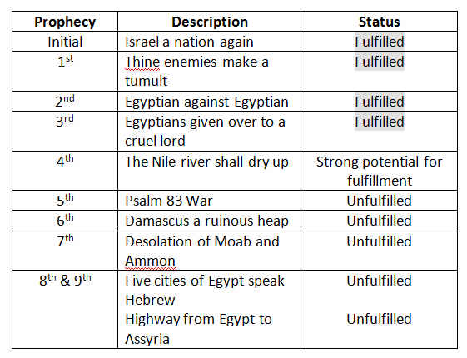
Notes:
The first three of these prophecies appear to be fulfilled and the fourth is on the verge of fulfillment. And, as we said on the previous slide, the 5th, 6th and 7th prophecies could be fulfilled at anytime between now and the end of the Tribulation period. The 8th and 9th prophecies are likely to be fulfilled during the Millennial Reign of Christ.

Slide 41
Ezekiel’s War is another end time prophecy. The question is does it occur before the Millennial Reign or after?
Currently the conditions described at the time of Ezekiel’s War does not match the current world conditions. Also, the references to Gog and Magog only occur in Ezekiel 38 & 39 and in Revelation 20. The reference in Revelation 20 obviously occurs following the Millennial Reign of Christ.
Copyright © 2020 by Barney Rapp
Notes:
Read the slide above.

Slide 42
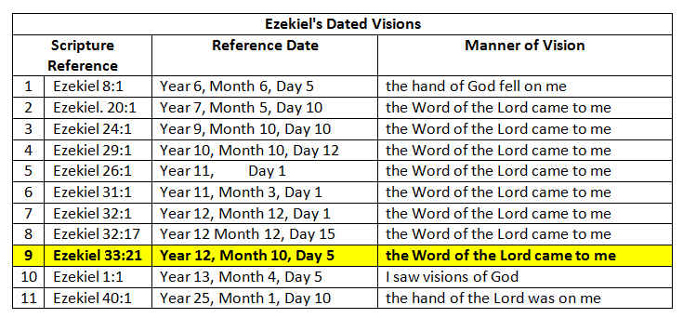
The real question becomes, did Ezekiel have 52 visions or did he have just 13 dated visions with multiple sub-visions.
Copyright © 2020 by Barney Rapp
Notes:
For years now, theologians have approached Ezekiel as a book of 52 individual visions. But, it is interesting that Ezekiel only dated 13 of the visions. Why did he date some and not others? Let’s take a look at the 13 dated visions and consider Ezekiel’s further hearings from God as sub-visions. Specifically, let’s look at Ezekiel’s 9th vision that contains the Gog and Magog prophecy.

Slide 43
Copyright © 2020 by Barney Rapp
Notes:
What we see when we look at Ezekiel in this manner is a dated vision occurring at Ezekiel 33:21 and having 7 sub-visions. Let’s see if there might be a historical sequence to these sub-visions. What we see on this slide is: 1. A curse against the enemy inhabitants of the promised land.
2. A curse against the shepherds of Israel.
3. A curse against Mount Seir.

Slide 44
Copyright © 2020 by Barney Rapp
Notes:
As we continue to look for a sequential flow in these prophecies, 1. The promised land is to be blessed and yield fruit.
we see the following: 2. God promises to gather Israel back to the land.
3. The dry bones representing the extinct house of Israel shall be restored to the land.
It’s starting to look like a sequence of events as we progress through history. The 5th sub-vision looks a lot like Israel today.

Slide 45
Copyright © 2020 by Barney Rapp
Notes:
As we continue looking, the 6th sub-vision paints a picture of all of Israel being fully restored to the land. It further promises that David will be king over them. This gives us a picture of the Millennial Reign of Christ (King David). This hasn’t happened yet, but it isn’t far off. The 7th and last sub-vision is the Gog and Magog war. As we look at the sequence of these 7 sub-visions all of a sudden it looks like the only Gog and Magog war occurs following the Millennium and aligns with Revelation chapter 20.
Furthermore, If we were to review the other 12 dated prophecies by Ezekiel, we would find the same sequential pattern of events as we just saw here.

Slide 46
Notes:
The major point of this slide is to present an idea of where we are on God’s prophetic timeline. Many people today are looking for Ezekiel’s War to occur at any time, yet it is likely to occur 1,000 years from now.

Slide 47
The Three Woes
A Guide to Understanding Revelation and End Time Prophecies
Day 2
Copyright © 2020 by Barney Rapp
Notes:
Welcome back to day 2 of our Revelation Bible Study. On our first day of the Bible Study, we discovered the hidden Timeline that is within the Book of Revelation and examined how to apply it to our study and understanding of the Book of Revelation. Following that, we looked at a number of other End Time prophecies to see where were are in relation to God’s calendar of End Time events.

Slide 48
The Three Woes
A Guide to Understanding Revelation and End Time Prophecies
Bible Study
Day 1 - Discovering Revelation’s T imeline & Are We Living in the End Times?
Chapters 1 thru 4
Day 2 - Understanding Revelation’s Mysteries & God's Assigned Feast Days
Chapters 5 thru 7
Day 3 - Post End Time Prophecies & The Rapture of the Church
Chapters 8 thru 11 and Bonus Material on the Rapture
Copyright © 2020 by Barney Rapp
Notes:
On Day 2 we are going to look at some other End Time scriptures to see if they support the Revelation time frame we learned about yesterday. All other prophetic scriptures must work with and support our time frame or our understanding is incorrect. The first scripture we will look at to validate our understanding is the Olivet Discourse. The Olivet Discourse is found in Matthew, Mark and Luke, but we will only be using Matthew’s account for today’s study. As we conclude today’s study, we are going to look at God’s assigned feast days as given in Leviticus.

Slide 49
Notes:
Just for reference, all of the material we studied yesterday was taken from the first four chapters of the book, “The Three Woes: A Guide to Understanding Revelation and End Time Prophecies”. Today the material we will be studying will be from chapters five through seven of “The Three Woes”.

Slide 50
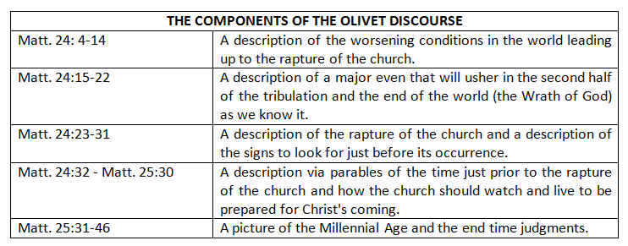
The Olivet Discourse
Copyright © 2020 by Barney Rapp
Notes:
The Olivet Discourse can be confusing until we break it out into sections like this. First Jesus talks about conditions leading upto the rapture of the church. Next, Christ begins telling about an event that will usher in the second half of the great tribulation. He then returns to describing the rapture of the church. Why Jesus digressed in the middle of the discussion of the rapture is unknown, but once we recognize this fact, it makes understanding the Olivet Discourse much easier.

Slide 51
As we look at Matt. 24:4 – 14, what are the signs Jesus told us to look for?
Copyright © 2020 by Barney Rapp
Notes:
Read the slide. So let’s check out the signs.

Slide 52
As we look at Matt. 24:4 – 14, what are the signs Jesus told us to look for?
Wars
Rumors of wars
Pestilences
Earthquakes
Afflictions
Betrayals
Copyright © 2020 by Barney Rapp
Notes:
Here on this slide, we can see 6 signs Jesus told us to look for: 1. Wars 2. Rumors of Wars 3. Pestilences
4. Earthquakes 5 Afflictions and 6. Betrayals

Slide 53
As we look at Matt. 24:4 – 14, what are the signs Jesus told us to look for?
Deception!
Deception!
Deception!
Copyright © 2020 by Barney Rapp
Notes:
But, much of the time we miss this sign and yet Jesus warned us three times to watch for this sign. None of the other signs were mentioned more than once. And yet we still tend to overlook this one. Deception, Deception, Deception!

Slide 54
How did the serpent beguile Adam and Eve in the Garden of Eden?
Copyright © 2020 by Barney Rapp
Notes:
Read the slide.

Slide 55
How did the serpent beguile Adam and Eve in the Garden of Eden?
Deception!
Copyright © 2020 by Barney Rapp
Notes:
Deception!

Slide 56
How did the serpent beguile Adam and Eve in the Garden of Eden?
Deception!
Does anyone see deception in our time?
Copyright © 2020 by Barney Rapp
Notes:
Does anyone see deception in our time?

Slide 57
Here’s a hot topic, Global Warming!
Copyright © 2020 by Barney Rapp
Notes:
Read the slide.

Slide 58
Here’s a hot topic, Global Warming!
When the term Global Warming didn’t go over so well, it was renamed to Climate Change.
Copyright © 2020 by Barney Rapp
Notes:
When the term Global Warming didn’t go over so well, it was renamed to Climate Change.

Slide 59
Here’s a hot topic, Global Warming!
When the term Global Warming didn’t go over so well, the name was changed to Climate Change.
Does anyone see deception here?
Copyright © 2020 by Barney Rapp
Notes:
Does anyone see deception here?

Slide 60
Here’s a hot topic, Global Warming!
When the term Global Warming didn’t go over so well, the name was changed to Climate Change.
Does anyone see deception here?
How about believing God’s Word?
Copyright © 2020 by Barney Rapp
Notes:
How about believing God’s Word?

Slide 61
Here’s a hot topic, Global Warming!
When the term Global Warming didn’t go over so well, the name was changed to Climate Change.
Does anyone see deception here?
How about believing God’s Word?
"While the earth remaineth, seedtime and harvest, cold and heat, and summer and winter, and day and night shall not cease". Gen. 8:22
Copyright © 2020 by Barney Rapp
Notes:
Read the scripture above. That’s what God’s Word has to say about Global Warming. You know, How ironic it is, that the world tells us that climate change is going to destroy the world, yet God tells us in Revelation how He will destroy the earth one day and the world chooses to scoff. Just another evidence that we are truly living in the end times.

Slide 62
California and other states are now offering non-binary options in place of male and female for birth certificate designations. Yet if you choose to disapprove of this progressive or liberal life style in any way, you are labeled a bigot, a purveyor of hate speech, and in some places you may be charged with a crime.
Copyright © 2020 by Barney Rapp
Notes:
Read the slide.

Slide 63
California and other states are now offering non-binary options in place of male and female for birth certificate designations. Yet if you choose to disapprove of this progressive or liberal life style in any way, you are labeled a bigot, a purveyor of hate speech, and in some places you may be charged with a crime.
But what does God say about it?
Copyright © 2020 by Barney Rapp
Notes:
But what does God say about it?

Slide 64
California and other states are now offering non-binary options in place of male and female for birth certificate designations. Yet if you choose to disapprove of this progressive or liberal life style in any way, you are labeled a bigot, a purveyor of hate speech, and in some places you may be charged with a crime.
But what does God say about it?
"So God created man in his own image, in the image of God created he him; male and female created he them". Genesis 1:27
Copyright © 2020 by Barney Rapp
Notes:
Read the scripture.

Slide 65
Everywhere we turn, the LGBTQ lifestyle is being pushed as the norm even though it is only about 4.5% of the United States population according to a 2017 Gallup poll.
Copyright © 2020 by Barney Rapp
Notes:
Read the slide.

Slide 66
Everywhere we turn, the LGBTQ lifestyle is being pushed as the norm even though it is only about 4.5% of the United States population according to a 2017 Gallup poll.
And even as they did not like to retain God in their knowledge, God gave them over to a reprobate mind, to do those things which are not convenient;
Romans 1:28
Copyright © 2020 by Barney Rapp
Notes:
Read the scripture.

Slide 67
One of the greatest deceptions of our age is that of Roe vs. Wade and the issue of abortion.
Copyright © 2020 by Barney Rapp
Notes:
Read the slide.

Slide 68
One of the greatest deceptions of our age is that of Roe vs. Wade and the issue of abortion.
The world wants to argue that a woman has the right to choose, but the church should argue that the woman made her choice when she chose to get pregnant. She had every right to take actions to prevent a pregnancy. She had every right to abstain from having sex, but she has no moral right to take the life of an innocent and helpless unborn child just because she and her partner made a prior bad choice.
Copyright © 2020 by Barney Rapp
Notes:
The world wants to argue that a woman has the right to choose, but the church should argue that the woman made her choice when she chose to get pregnant. She had every right to take actions to prevent a pregnancy. She had every right to abstain from having sex, but she has no moral right to take the life of an innocent and helpless unborn child just because she and her partner made a prior bad choice.

Slide 69
Does anyone see deceit and apostasy at work in our world today?
Copyright © 2020 by Barney Rapp
Notes:
Read the slide.

Slide 70
Does anyone see deceit and apostasy at work in our world today?
What we have been looking at are all signs of the end times.
Copyright © 2020 by Barney Rapp
Notes:
What we have been looking at are all signs of the end times.

Slide 71
Does anyone see deceit and apostasy at work in our world today?
What we have been looking at are all signs of the end times.
God said, “But as the days of Noe were, so shall also the coming of the Son of man be.
Matt. 24:37
Copyright © 2020 by Barney Rapp
Notes:
Read the scripture.

Slide 72
What were the other signs we were warned to watch for?
Copyright © 2020 by Barney Rapp
Notes:
Read the slide.

Slide 73
What were the other signs we were warned to watch for?
Wars
Rumors of wars
Pestilences
Earthquakes
Afflictions
Betrayals
We will conclude this look at the signs with one last sign that seems to be worth reviewing. Any guess as to which one it is? It’s in the list above.
Copyright © 2020 by Barney Rapp
Notes:
We will conclude this look at the signs with one last sign that seems to be worth reviewing. Any guess as to which one it is? It’s in the list above.

Slide 74
Betrayals
Specifically, society’s betrayal of our youth.
Copyright © 2020 by Barney Rapp
Notes:
Read the slide.

Slide 75
Betrayals
Specifically, society’s betrayal of our youth.
A company that the world has come to love and trust, we must now censor, and worry about what subtle message may be getting promoted to our very young children. Who is that company?
Copyright © 2020 by Barney Rapp
Notes:
A company that the world has come to love and trust, we must now censor, and worry about what subtle message may be getting promoted to our very young children. Who is that company?

Slide 76
Betrayals
Specifically, society’s betrayal of our youth.
A company that the world has come to love and trust, we must now censor, and worry about what subtle message may be getting promoted to our very young children. Who is that company?
Disney
Copyright © 2020 by Barney Rapp
Notes:
Disney!

Slide 77
Betrayals
Specifically, society’s betrayal of our youth.
It's not just the youngest children that are in danger. We see the same happening with our young adult children as well. Most colleges and universities have become safe zones, where conservative ideas and Christian values are not allowed to be discussed or even presented for consideration.
Copyright © 2020 by Barney Rapp
Notes:
It's not just the youngest children that are in danger. We see the same happening with our young adult children as well. Most colleges and universities have become safe zones, where conservative ideas and Christian values are not allowed to be discussed or even presented for consideration.

Slide 78
Betrayals
Specifically, society’s betrayal of our youth.
Many of the original centers of higher education were founded with the specific purpose of training ministers of the Gospel of Jesus Christ and promoting Christian values and Christian thought. Yet today most of Americas' centers of higher education have become centers of liberal thought and liberal ideas where conservative ideas and Christian values are unwelcome.
Copyright © 2020 by Barney Rapp
Notes:
Many of the original centers of higher education were founded with the specific purpose of training ministers of the Gospel of Jesus Christ and promoting Christian values and Christian thought. Yet today most of Americas' centers of higher education have become centers of liberal thought and liberal ideas where conservative ideas and Christian values are unwelcome.
There are many other signs we could look at like calling evil good and good evil, but for now, let’s turn our focus back to Revelation.

Slide 79
As we finish looking at the signs in Matthew 24, we next want to look at the seals in Revelation 6 and see how they parallel the signs of the Olivet Discourse.
Copyright © 2020 by Barney Rapp
Notes:
As we finish looking at the signs in Matthew 24, we next want to look at the seals in Revelation 6 and see how they parallel the signs of the Olivet Discourse.

Slide 80
As we finish looking at the signs in Matthew 24, we next want to look at the seals in Revelation 6 and see how they parallel the signs of the Olivet Discourse.
Copyright © 2020 by Barney Rapp
Notes:
On this slide we can see how the signs from the Olivet Discourse parallel the seals from the Book of Revelation.

Slide 81
Many people focus on the rider of the white horse. Some claim the rider is Christ while others believe the rider is the antichrist. We don't assign personages to the other riders and neither should they do so to the first rider.
We tend to attribute white to good and black to evil. The white horse appears to be a good horse but it's going forth conquering, and to conquer. Evil, deceptive intentions.
Copyright © 2020 by Barney Rapp
Notes:
Read the text above the table.

Slide 82
Here on the second seal the correlation between taking peace from the earth and wars and rumours of wars is very easy to see. If you don't have peace, you are at war.
Copyright © 2020 by Barney Rapp
Notes:
Read the text above the table.

Slide 83
In Bible days, a penny was a days wages. What the scripture is telling us here is that it will take a days wages to pay for a meal. The lack of food will cause its cost to greatly increase.
Copyright © 2020 by Barney Rapp
Notes:
Read the text above the table.

Slide 84
Here we see mankind still being killed with the sword and with hunger, but now the fourth seal adds with death, and the beasts of the earth. Pestilences, can anyone say COVID-19, Aids, smallpox, black plaque?
Copyright © 2020 by Barney Rapp
Notes:
Read the text above the table.

Slide 85
In the days ahead there is going to arise great persecution against Christ’s Church.
Copyright © 2020 by Barney Rapp
Notes:
Read the text above the table.

Slide 86
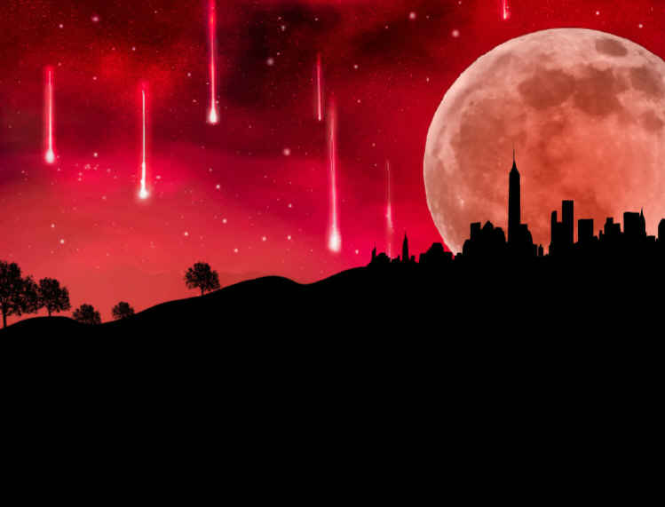
Copyright © 2020 by Barney Rapp
Notes:
Once you begin to understand Revelation, you will soon discover that the Sixth Seal has much to do with unraveling end time scripture as does the three woes. What we see here in this graphic is a representation of the sun becoming black as sackcloth, the moon becoming as blood and the stars of heaven falling to earth.

Slide 87
The Cosmic Signs
And I beheld when he had opened the sixth seal, and, lo, there was a great earthquake; and the sun became black as sackcloth of hair, and the moon became as blood; And the stars of heaven fell unto the earth, even as a fig tree casteth her untimely figs, when she is shaken of a mighty wind. And the heaven departed as a scroll when it is rolled together; and every mountain and island were moved out of their places.
Rev 6:12-14 KJV
Copyright © 2020 by Barney Rapp
Notes:
Read the scripture above. Not only is this account of the Cosmic Signs given to us here by John in Revelation, but we can also see these cosmic signs in Matthew 24, Mark 13, Luke 21, in addition to Isaiah 13, and Joel 2 in the Old Testament. What that tells us, is that all six of these writers are telling us about the same event that will shortly be coming upon the world.

Slide 88
The Rapture of the Church
And the kings of the earth, and the great men, and the rich men, and the chief captains, and the mighty men, and every bondman, and every free man, hid themselves in the dens and in the rocks of the mountains; And said to the mountains and rocks, Fall on us, and hide us from the face of him that sitteth on the throne, and from the wrath of the Lamb: For the great day of his wrath is come; and who shall be able to stand?
Rev 6:15-17 KJV
Copyright © 2020 by Barney Rapp
Notes:
Read the scripture above. This section of scripture parallels Matthew 24:30 where we see Jesus coming in the clouds of heaven. But, some of you might be thinking that this sounds like the Battle of Armageddon.

Slide 89
Battle of Armageddon
And I saw three unclean spirits like frogs come out of the mouth of the dragon, and out of the mouth of the beast, and out of the mouth of the false prophet. For they are the spirits of devils, working miracles, which go forth unto the kings of the earth and of the whole world, to gather them to the battle of that great day of God Almighty. Behold, I come as a thief. Blessed is he that watcheth, and keepeth his garments, lest he walk naked, and they see his shame. And he gathered them together into a place called in the Hebrew tongue Armageddon.
Rev 16:13-16 KJV
Copyright © 2020 by Barney Rapp
Notes:
Read the scripture above. The scripture depicting the rapture of the church was in Revelation 6 and the Battle of Armageddon here is taking place in Revelation 16. We know Revelation is sequential and we saw with our main Revelation time line chart that the opening of the seals continues out to Rev. 16:17, in fact that is the next verse following this scripture. It is also the verse where we said the opening of the seventh seal is complete. The scene from the end of Revelation chapter 6, the opening of the sixth seal must be the rapture of the church. So, now that we know it is not the Battle of Armageddon, let’s return to the Cosmic Signs.

Slide 90
The Cosmic Signs
And Rapture of the Church
For as the lightning cometh out of the east, and shineth even unto the west; so shall also the coming of the Son of man be. For wheresoever the carcase is, there will the eagles be gathered together. Immediately after the tribulation of those days shall the sun be darkened, and the moon shall not give her light, and the stars shall fall from heaven, and the powers of the heavens shall be shaken: And then shall appear the sign of the Son of man in heaven: and then shall all the tribes of the earth mourn, and they shall see the Son of man coming in the clouds of heaven with power and great glory. And he shall send his angels with a great sound of a trumpet, and they shall gather together his elect from the four winds, from one end of heaven to the other.
Matt 24:27-31 KJV
Copyright © 2020 by Barney Rapp
Notes:
Read the scripture above. Here we see the Cosmic Signs as described by Jesus and He clearly ties those signs to His coming and the Rapture of the Church.

Slide 91
As we leave the Cosmic Signs behind, the next thing we see is the sealing of the 144,000 children of Israel.
Copyright © 2020 by Barney Rapp
Notes:
Read the slide.

Slide 92
As we leave the Cosmic Signs behind, the next thing we see is the sealing of the 144,000 children of Israel.
Following this, we see a great multitude in heaven.
After this I beheld, and, lo, a great multitude, which no man could number, of all nations, and kindreds, and people, and tongues, stood before the throne, and before the Lamb, clothed with white robes, and palms in their hands;
Rev 7:9 KJV
Copyright © 2020 by Barney Rapp
Notes:
Read the scripture above. These are not the tribulation saints as many have supposed, remember, the tribulation does not begin until Revelation 9:14. This is the raptured church standing before God’s throne immediately following the Cosmic Signs of Revelation Chapter 6. The remainder of Revelation chapter 7 is all a picture of the raptured church before God’s throne. And then, the next thing to happen is the opening of the 7th seal in Revelation 8:1.
To see the tribulation saints, we would need to go to Revelation 15:2 where John sees “a sea of glass mingled with fire, and them that had gotten the victory over the beast, and over his image, and over his mark, and over the number of his name, stand on the sea of glass, having the harps of God.”

Slide 93
Before we move on to look at the three woes, let’s briefly review the first four trumpet angels, thus far we have skipped them.
Notes:
Read the slide.

Slide 94
Before we move on to look at the three woes, let’s briefly review the first four trumpet angels, thus far we have skipped them.
1st Trumpet Angel | Third of trees and green grass is burnt up
2nd Trumpet Angel | Third part of the sea became blood
3rd Trumpet Angel | Third part of the waters made bitter
4th Trumpet Angel | Third part of the sun, moon and stars darkened
Notes:
Read the actions of the first four Trumpet Angels.

Slide 95
Before we move on to look at the three woes, let’s briefly review the first four trumpet angels, thus far we have skipped them.
1st Trumpet Angel | Third of trees and green grass burnt up
2nd Trumpet Angel | Third part of the sea became blood
3rd Trumpet Angel | Third part of the waters made bitter
4th Trumpet Angel | Third part of the sun, moon and stars darkened
All actions of these four Trumpet Angels are completed at least five months before the beginning of the seven years of Tribulation.
Notes:
All actions of these four Trumpet Angels are completed at least five months before the beginning of the seven years of Tribulation.

Slide 96
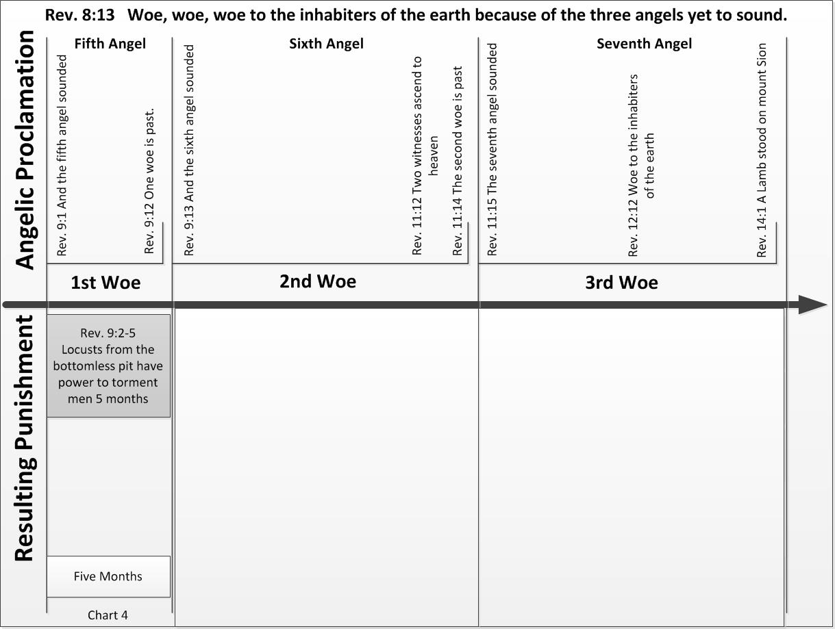
Notes:
The First Woe. Rev. 9:7-10 John sees locusts like horses with crowned heads like gold, and faces like men. They had hair like women, and breastplates like iron; and wings that sounded like many chariots. They had tails like scorpions, and there were stings were in their tails: and their power was to hurt men five months. Looking at this description from our modern day perspective, the description sounds a lot more like an apache helicopter with stinger missiles being piloted by a man wearing a gold helmet than it does a locust. Notice again the time from for this woe is 5 months, and it occurs before the beginning of the Tribulation.

Slide 97
Notes:
The Second Woe goes from Rev. 9:13 thru Rev. 11:14. A third of men are slain and the holy city is trod under foot for 42 months, and the two witnesses prophecy for 1,260 days. Then they are killed. The time span for this is 3.5 years, this is the first half of the tribulation.

Slide 98
Copyright © 2020 by Barney Rapp
Notes:
The Third Woe goes from Rev.11:15 thru Rev. 14:1. The woman, Israel, flees to the wilderness for 1,260 days, the serpent, the devil, persecutes the woman for time, times, and half a time. The beast, the antichrist makes war with the saints, people of Israel, for 42 months. All three of these time frames are 3.5 years and they will all run concurrently with each other. Notice: the second and third woe together equal 7 years. This is the seventieth week of Jacob’s trouble, or what we call the seven years of tribulation.

Slide 99
Copyright © 2020 by Barney Rapp
Notes:
The first half of the tribulation is dominated by the work of the Two Witnesses, we don’t know who they are, but I think maybe the witnesses are Elijah and John. Because when John ate the Little book in Rev. 10:9-11, it was sweet in his mouth but bitter in his belly and he is told he will have to prophesy again before many people.
The second half of the tribulation is dominated by the satanic trinity; satan, the antichrist and the false prophet.

Slide 100
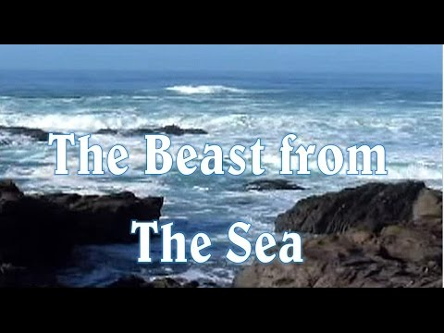
Copyright 2020 by Barney Rapp
Notes:
The seventh trumpet sounds the third woe at Rev. 11:15. At this point God gives us a brief update on what this means in heaven and why the devil hates Israel so much. It means the last seal of the seven sealed scroll has been broken, and that is very important as we will see later. Chapter 12 of Revelation gives us a short spiritual history lesson describing the conflict between Israel, the woman described in Revelation chapter 12 and satan.
Following this we find ourselves at Rev. 13:1.
As we begin reading in Rev. 13:1, the next thing we see described is a beast rising up out of the sea. This is where most people would put a scary looking picture of a beast coming out of the sea. But this beast is probably a political or governmental alliance of seven nations, the seven heads. The man we call the antichrist may rise to be the leader of this multi-nation alliance and assumes the identity of the beast. OR, maybe he rises to the top position another way, let’s look at the next slide.

Slide 101
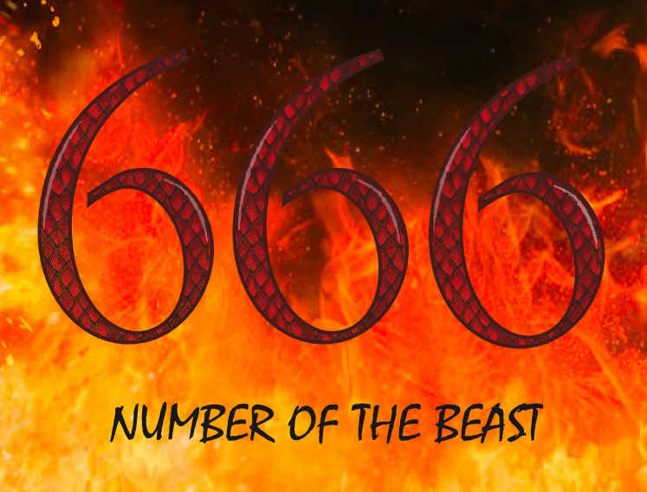
The work of the satanic trinity
Copyright © 2020 by Barney Rapp
Notes:
The satanic trinity! Satan, the Antichrist and the False Prophet. We won’t talk much about satan here , just his two henchmen, but satan is behind them, as they derive their power from the devil. You know, back in 2000 I was working with a coworker and our conversation turned to a spiritual and prophetic subject matter and I mentioned the Mark of the Beast and the number 666. I watched as my friend’s face got a look on it like I was a total lunatic, ready for the funny farm. My friend had never heard of the mark of the beast or the number 666. But, How many today have not heard of the Mark of the Beast or the number of the beast, 666?
It seems, that in the past 20 years, the Mark of the Beast and the number 666 have become part of our everyday language. No longer do people look at me like I’m a lunatic when I talk about such subjects.

Slide 102
The Antichrist
And I saw one of his heads as it were wounded to death; and his deadly wound was healed: and all the world wondered after the beast. And they worshipped the dragon which gave power unto the beast: and they worshipped the beast, saying, Who is like unto the beast? who is able to make war with him? And there was given unto him a mouth speaking great things and blasphemies; and power was given unto him to continue forty and two months.
Rev 13:3-5 KJV
Copyright © 2020 by Barney Rapp
Notes:
Read all the scripture. Notice that the scripture does not say that it is a head wound, but that one of his heads is wounded to death. One leader out of this seven nation alliance receives the deadly wound. This is the one that becomes the antichrist and is given power for 42 months as the satanic trinity works to implement their one world government by force.
Based on the wording of the scripture here we might question whether the antichrist is the recovered man or, is the man’s body being used by a demonic spirit? We don’t know.

Slide 103
The Antichrist
And he opened his mouth in blasphemy against God, to blaspheme his name, and his tabernacle, and them that dwell in heaven. And it was given unto him to make war with the saints, and to overcome them: and power was given him over all kindreds, and tongues, and nations. And all that dwell upon the earth shall worship him, whose names are not written in the book of life of the Lamb slain from the foundation of the world.
Rev 13:6-8 KJV
Copyright © 2020 by Barney Rapp
Notes:
Read the highlighted scripture above. Here we see the antichrist making war with the saints for 42 months. These saints are the saints from the house of Israel. Remember God has turned His focus from the Gentiles to the Jewish people. We are told that all who do not have their names written in the book of life will worship him. We have been taught that all who do not worship the beast and are beheaded will be saved, but that is not what this scripture says. This scripture implies that all individuals who do not worship the beast already have their names written in the book of life. Their salvation probably came through the work and ministry of the 144,000 and the two witnesses. It will take more than just human strength to refuse to worship the beast and to refuse to receive his mark.

Slide 104
The False Prophet
And I beheld another beast coming up out of the earth; and he had two horns like a lamb, and he spake as a dragon.
Rev 13:11 KJV
Copyright © 2020 by Barney Rapp
Notes:
Read the scripture. The next thing we see is another beast coming out of the earth, this beast is the false prophet. He had an image made of the first beast and causes all to worship the image.

Slide 105
The False Prophet
And deceiveth them that dwell on the earth by the means of those miracles which he had power to do in the sight of the beast; saying to them that dwell on the earth, that they should make an image to the beast, which had the wound by a sword, and did live. And he had power to give life unto the image of the beast, that the image of the beast should both speak, and cause that as many as would not worship the image of the beast should be killed.
Rev 13:14-15 KJV
Copyright © 2020 by Barney Rapp
Notes:
Read the highlighted scripture. Here we see an interesting point, if an individual will not worship the beast he is to be killed. An individual is not killed because they refuse the mark of the beast, they are killed because they refuse to worship the image of the beast. The mark is the individual’s proof that they submitted to worshiping the beast.

Slide 106
The False Prophet
And he causeth all, both small and great, rich and poor, free and bond, to receive a mark in their right hand, or in their foreheads: And that no man might buy or sell, save he that had the mark, or the name of the beast, or the number of his name.
Rev 13:16-17 KJV
Copyright © 2020 by Barney Rapp
Notes:
We tend to think of the mark of the beast as singular, but, there is not just one mark of the beast, but three marks to chose from.
The Mark of the Beast
The Name of the Beast What we see here is if an individual tries to buy or sell and does not have the mark, he will be reported to the authorties!
The Number of his name
The individual may chose to have this mark placed on either their right hand or forehead. These two locations provide the greatest temperature variations to provide human energy to charge a lithium battery to run an RFID chip.

Slide 107
What will the Mark of the Beast Be?
Copyright © 2020 by Barney Rapp
Notes:
Read the slide.

Slide 108
What will the Mark of the Beast Be?
1 RFID
Copyright © 2020 by Barney Rapp
Notes:
RFID

Slide 109
What will the Mark of the Beast Be?
1 RFID
2 Digital Tattoo Vaccine
Copyright © 2020 by Barney Rapp
Notes:
Digital Tattoo Vaccine

Slide 110
What will the Mark of the Beast Be?
1 RFID
2 Digital Tattoo Vaccine
3 Cryptocurrency
Copyright © 2020 by Barney Rapp
Notes:
Cryptocurrency

Slide 111
How About All Three?
1 RFID
2 Digital Tattoo Vaccine
3 Cryptocurrency
Copyright © 2020 by Barney Rapp
Notes:
How about all three?

Slide 112
Microsoft Technology Licensing, LLC (Bill Gates) has applied for a patent called 'Cryptocurrency System Using Body Activity Data'. It is described in Publication Number WO/2020/060606 and may be viewed at the WEB address listed below. It uses quantum dot technology to create a tattoo on the skin. Bill Gates is advocating that every person in the world must be vaccinated against the COVID virus.
https://patentscope.wipo.int/search/en/detail.jsf?docId=WO2020060606
Copyright © 2020 by Barney Rapp
Notes:
Read the slide.

Slide 113
The Mark of the Beast
It’s Not Far Off!
Copyright © 2020 by Barney Rapp
Notes:
Read the slide. But, the raptured church will be removed at least 3 years before the satanic trinity implements their evil plan.

Slide 114
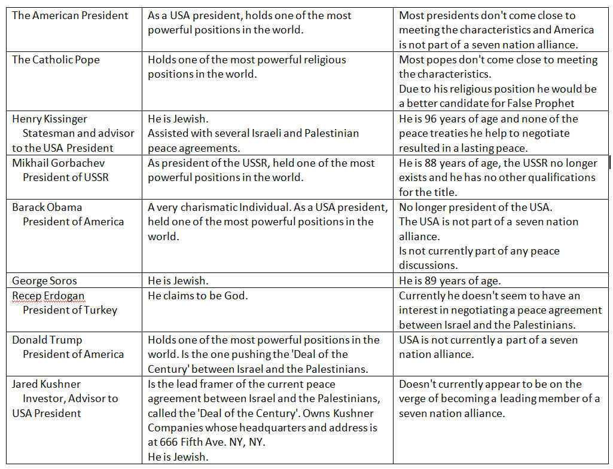
Copyright © 2020 by Barney Rapp
Notes:
Who is the antichrist? We don’t know who the antichrist is but here are some potential candidates.

Slide 115
St. Malachy was the archbishop of Armagh, Ireland in the 1100s. St. Malachy claimed to have a vision while visiting Rome. In his vision, he claimed to receive a short description of each pope that would be over the Catholic church. His vision resulted in a list of 112 popes in succession, with the 112th pope being the final pope. It is claimed that the record of St. Malachy's vision was recorded and deposited in the Vatican's Secret Archives and forgotten until its rediscovery there in 1590.
Copyright © 2020 by Barney Rapp
Notes:
Who is the False Prophet? As we researched this question, the only potential candidates were always a Pope. So here is a theory. Read the Slide.

Slide 116
If the prophecy was true, then Pope Benedict XVI would be the last pope before the final 112th pope. In 2013 Pope Benedict XVI resigned and Pope Francis became the 112th pope. Will Pope Francis turnout to be the false prophet of Revelation chapter 13? We don't know.
Copyright © 2020 by Barney Rapp
Notes:
Read the slide.

Slide 117
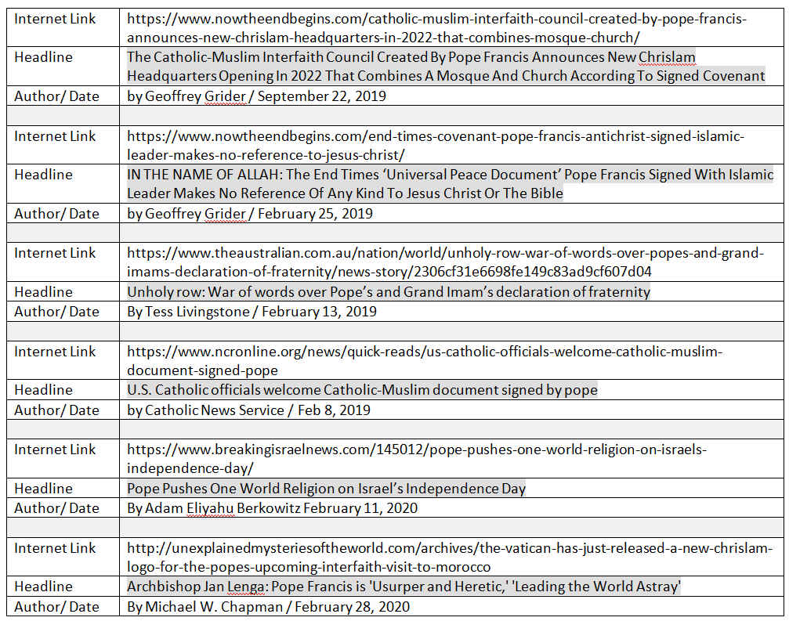
Copyright © 2020 by Barney Rapp
Notes:
Here are some references to articles where individuals are pointing out some very suspicious actions. You decide.

Slide 118
Copyright © 2020 by Barney Rapp
Notes:
These feast days were assigned by God back in Leviticus 23. There are 4 spring feast days and 3 fall feast days. Jesus fulfilled the 4 spring feast days over 2,000 years ago.

Slide 119
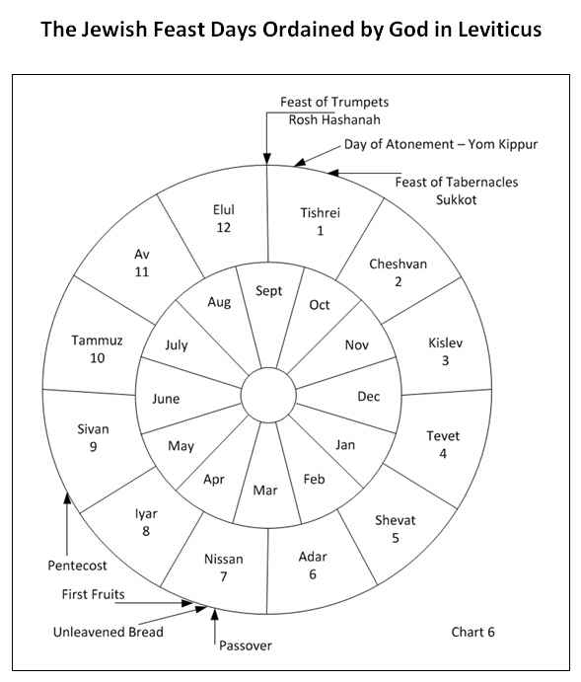
Copyright © 2020 by Barney Rapp
Notes:
Here are the feast days as compared to our Gregorian calendar.

Slide 120
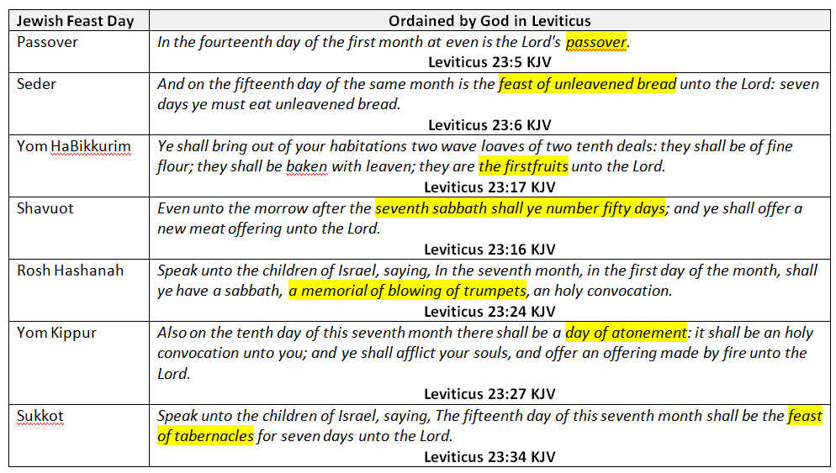
God’s Ordained Feast Days
Copyright © 2020 by Barney Rapp
Notes:
Here we can see God’s declared feast days from the book of Liviticus.

Slide 121
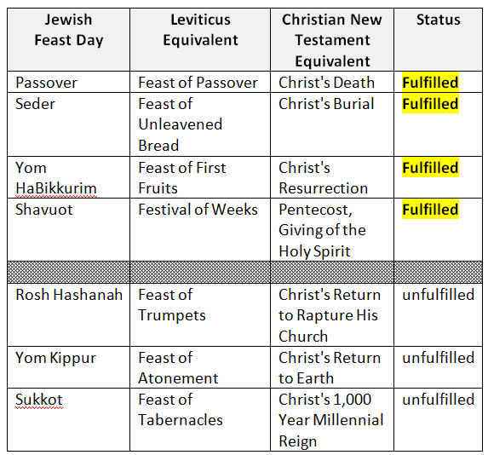
Copyright © 2020 by Barney Rapp
Notes:
On this slide, we can see where the spring feast days were fulfilled through Christ’s earthly ministry.

Slide 122
No Man Knows the Day Nor Hour
Copyright © 2020 by Barney Rapp
Notes:
Read the slide.

Slide 123
No Man Knows the Day Nor Hour
Watch therefore, for ye know neither the day nor the hour wherein the Son of man cometh.
Matthew 25:13 KJV
Copyright © 2020 by Barney Rapp
Notes:
Read the scripture. Many will quote the scripture to prove that we can not know the day nor the hour and we shouldn’t be making predictions, but it is interesting that the admonition begins with the word “WATCH”.

Slide 124
No Man Knows the Day Nor Hour
Watch therefore, for ye know neither the day nor the hour wherein the Son of man cometh.
Matthew 25:13 KJV
Ye hypocrites, ye can discern the face of the sky and of the earth; but how is it that ye do not discern this time?
Luke 12:56 KJV
Copyright © 2020 by Barney Rapp
Notes:
Read the bottom scripture. God expects us to discern the time, the season. We won’t know the day not the hour of His coming but we are to recognize the season.

Slide 125
No Man Knows the Day Nor Hour
When they therefore were come together, they asked of him, saying, Lord, wilt thou at this time restore again the kingdom to Israel? And he said unto them, It is not for you to know the times or the seasons, which the Father hath put in his own power.
Acts 1:6-7 KJV
But of the times and the seasons, brethren, ye have no need that I write unto you. For yourselves know perfectly that the day of the Lord so cometh as a thief in the night. For when they shall say, Peace and safety; then sudden destruction cometh upon them, as travail upon a woman with child; and they shall not escape.
1 Thessalonians 5:1-3 KJV
Copyright © 2020 by Barney Rapp
Notes:
Read these two scriptures. Upon first glance, these two scriptures may seem to contradict each other, but they don’t. In Acts, Jesus is talking about the restoration of the kingdom to Israel, but in Thessalonians, Paul is talking about the Lord’s second coming.

Slide 126
Think about the world, when Christ returns to rapture His church, He will circumvent the earth in the twinkling of an eye collecting His saints. A twinkle is less time than it takes to blink your eye. For some His return will be today but for others it will be yesterday or tomorrow depending on which side of the International Date Line you are living on. For some He will come at midnight but for others He will come at noon day. Think about the New Year celebration in the western hemisphere, it can be early afternoon on New Year's eve and people in America are watching Sidney, Australia ring in the New Year. Our earth is divided into twenty four time zones, and for each one the rapture will occur at a different hour. As the Word tells us, we will not know the day nor the hour, but we can know the time and the season.
Copyright © 2020 by Barney Rapp
Notes:
Read the slide.

Slide 127
The Three Woes
A Guide to Understanding Revelation and End Time Prophecies
Day 3
Copyright © 2020 by Barney Rapp
Notes:
Welcome back to day 3 of our Revelation Bible Study. On our second day of the Bible Study, looked at some other End Time scriptures to see if they supported the Revelation time frame we learned about on our first day. The first scripture we looked at to validate our understanding was the Olivet Discourse, and what we saw was a correlation between the Olivet Discourse and the opening of the seals in Revelation chapter 6. We learned about the Cosmic signs and saw haw they tied together scriptures from Revelation, the Olivet Discourse in Matthew, Mark & Luke, along with Isaiah and Joel. We learned about the satanic trinity, the mark of the beast and their one world system. Lastly, we learned about the Jewish feast days and how Jesus fulfilled the four spring feast days while He was here on earth. The next feast day to be fulfilled is the Feast of Trumpets, the Rapture of the Church on Rosh Hashanah.

Slide 128
The Three Woes
A Guide to Understanding Revelation and End Time Prophecies
Bible Study
Day 1 - Discovering Revelation’s T imeline & Are We Living in the End Times?
Chapters 1 thru 4
Day 2 - Understanding Revelation’s Mysteries & God's Assigned Feast Days
Chapters 5 thru 7
Day 3 - Post End Time Prophecies & The Rapture of the Church
Chapters 8 thru 11 and Bonus Material on the Rapture
Copyright © 2020 by Barney Rapp
Notes:
On Day 3 we are going to look at the prophesied return of Jesus Christ and why that prophecy is so important to all of us. We are going to look at why we need a savior and why a blood sacrifice is so important. We will examine the three types of death and man's purpose in life. We will examine the role of the saints and the battle of Armageddon. We will examine the Seven Sealed Scroll and learn about the Law of the Kinsman Redeemer and how these last two are related. We will learn about the roll of the saints at the close of the tribulation period and through the Millennial Reign of Christ. We will conclude by examining the spiritual condition of the church and of our society and discovering what God has to say about returning to Him spiriutally.

Slide 129
Notes:
Just for reference, all of the material we studied yesterday was taken from chapters five through seven of the book, “The Three Woes: A Guide to Understanding Revelation and End Time Prophecies”. Today the material we will be studying will be from chapters eight through eleven of “The Three Woes”.

Slide 130
The Greatest Prophecy of All,
The Return of Jesus Christ
Copyright © 2020 by Barney Rapp
Notes:
Read the slide.

Slide 131
The Greatest Prophecy of All,
The Return of Jesus Christ
Why is the fulfillment of the this prophecy so necessary?
Copyright © 2020 by Barney Rapp
Notes:
Why is the fulfillment of the this prophecy so necessary?

Slide 132
The Greatest Prophecy of All,
The Return of Jesus Christ
Why is the fulfillment of the this prophecy so necessary?
The Answer is
SIN
Copyright © 2020 by Barney Rapp
Notes:
The answer is sin.

Slide 133
When Adam and Eve sinned against God by partaking of the forbidden fruit, not only did they sin personally, but through them, the sin nature and the knowledge of good and evil entered the human race.
Copyright © 2020 by Barney Rapp
Notes:
Read the slide.

Slide 134
When Adam and Eve sinned against God by partaking of the forbidden fruit, not only did they sin personally, but through them, the sin nature and the knowledge of good and evil entered the human race.
Not only did Adam and Eve commit personal sin, but the sin nature entered the human race and passed it on to their offspring Cain and Abel and from there on to all the human race.
Copyright © 2020 by Barney Rapp
Notes:
Not only did Adam and Eve commit personal sin, but the sin nature entered the human race and passed it on to their offspring Cain and Abel and from there on to all the human race.

Slide 135
So what we see from the time of Adam and Eve until the time of Noah is mankind's spiritual decline and desperate need for a Savior. We and all mankind need a Savior to forgive us of all our personal sins as well as to deliver us from the sin nature. The great news is, God had a plan from the very beginning when He created Adam, to provide us with a Savior and to deliver us. That plan was fulfilled approximately four thousand years after Adam and Eve partook of the forbidden tree. The fulfillment came when a young virgin girl named Mary conceived a child of the Holy Spirit and bear that child calling Him Jesus.
Copyright © 2020 by Barney Rapp
Notes:
Read the slide.

Slide 136
Therefore the Lord himself shall give you a sign; Behold, a virgin shall conceive, and bear a son, and shall call his name Immanuel.
Isaiah 7:14 KJV
Now the birth of Jesus Christ was on this wise: When as his mother Mary was espoused to Joseph, before they came together, she was found with child of the Holy Ghost.
Matthew 1:18 KJV
Copyright © 2020 by Barney Rapp
Notes:
Read the two scripture verses.

Slide 137
We need a Savior because we need to be forgiven of our sins and made holy. We can't do it for ourselves and no one else who is sinful, or has ever sinned, can do it for us. For God's justice to be satisfied, we must either accept the punishment ourselves or our debt and punishment must be paid by someone who is without sin and someone who has never sinned. God provided that someone. Jesus is the only one who can claim that title of being sinless and without the sin nature.
Copyright © 2020 by Barney Rapp
Notes:
Read the slide.

Slide 138
For the wages of sin is death; but the gift of God is eternal life through Jesus Christ our Lord.
Romans 6:23 KJV
For God so loved the world, that he gave his only begotten Son, that whosoever believeth in him should not perish, but have everlasting life.
John 3:16 KJV
Copyright © 2020 by Barney Rapp
Notes:
Read the scripture verses.

Slide 139
Jesus alone can come forward and take our place. He is the only One who has never sinned and the only One who did not inherit the sin nature from Adam. Jesus received His humanity from Mary, His mother, and He received His sinless nature from the Holy Spirit. Jesus, through the shedding of His blood, makes atonement for our sins and makes us completely new creatures in Him.
Copyright © 2020 by Barney Rapp
Notes:
Read the slide.

Slide 140
For he hath made him to be sin for us, who knew no sin; that we might be made the righteousness of God in him.
2 Corinthians 5:21 KJV
Follow peace with all men, and holiness, without which no man shall see the Lord:
Hebrews 12:14 KJV
By the which will we are sanctified through the offering of the body of Jesus Christ once for all.
Hebrews 10:10 KJV
Copyright © 2020 by Barney Rapp
Notes:
Read the scriptures.

Slide 141
The Blood Sacrifice
Through Jesus and the shedding of His blood, we can obtain forgiveness of sins and have that sin nature taken from us. It is from no acts or works that we can do but only through the sinless shed blood of Jesus. The only part that we, as mere humans, play in this redemptive process is to ask for God's forgiveness with a repentant heart and attitude, and accept the free gift of pardon that God provided through His redemptive plan. Lost and fallen mankind needed a Savior to provide a means for man to escape God's judgment and that Savior is the God-Man Jesus Christ.
Copyright © 2020 by Barney Rapp
Notes:
Read the slide.

Slide 142
We Need a Savior to Escape the Second Death
Earlier we talked about Adam and Eve dying when they ate the forbidden fruit. Some might say, they didn't die, they lived to be over nine hundred years old. That is true, Adam did live to be nine hundred and thirty years old. But, there is more than one type of death. there are in fact three types of death: 1) physical death, 2) spiritual death, and 3) eternal death.
Copyright © 2020 by Barney Rapp
Notes:
Read the slide.

Slide 143
When Adam and Eve disobeyed God, they died spiritually. It wasn't the fruit that caused the death but the act of disobedience. When God created Adam and Eve, they were holy beings created in God's image. Through that act of disobedience they lost their holy nature and it was replaced with the sinful nature that all mankind has inherited ever since. That sinful nature is spiritual death. Adam and Eve, like the rest of mankind, both eventually died a physical death as well.
Copyright © 2020 by Barney Rapp
Notes:
Read the slide.

Slide 144
So where does eternal death come in? When God created man He created him in His own image. We are eternal beings like God is eternal. Our being, our essence, is our spirit. Our bodies are formed from the dust of the earth. When God breathed into man the breath of life, He was breathing our spirit, our essence, into the physical body that was created from the dust of the earth. This merging of the body and spirit creates what is called a living soul.
Copyright © 2020 by Barney Rapp
Notes:
Read the slide.

Slide 145
So God created man in his own image, in the image of God created he him; male and female created he them.
Genesis 1:27 KJV
And the Lord God formed man of the dust of the ground, and breathed into his nostrils the breath of life; and man became a living soul
Genesis 2:7 KJV
Copyright © 2020 by Barney Rapp
Notes:
Read the scriptures.

Slide 146
Notice the order of creation in the verses above. In Genesis chapter 1 verse 27, God created man the spirit. Then in Genesis chapter 2 verse 7, God created the physical man from the dust. Next, God breathed the breath of life, man's spirit, into the nostrils, of the physical body. This is when man became a living soul. When a man's physical body dies his spirit or essence leaves the body but that spirit does not die, it is eternal. We see the proof of this below in the verse from the Book of James.
For as the body without the spirit is dead, so faith without works is dead also.
James 2:26 KJV
Copyright © 2020 by Barney Rapp
Notes:
Read the slide.

Slide 147
As we examine the verse from James, it is very important to note that the body without the spirit is dead, but it doesn't say that the spirit without the body is dead. When the body dies and the spirit leaves the body, that spirit would be called a disembodied spirit. It still exists only without physical form. The scripture tells us that the spirit of man returns to God when the physical body dies. That spirit of the man will still retain all the memories, all the feelings and all the emotions that the man had while alive in the body. To understand this, read the story about Lazarus and the rich man.
Then shall the dust return to the earth as it was: and the spirit shall return unto God who gave it.
Ecclesiastes 12:7 KJV
Copyright © 2020 by Barney Rapp
Notes:
Read the slide.

Slide 148
There was a certain rich man, which was clothed in purple and fine linen, and fared sumptuously every day: And there was a certain beggar named Lazarus, which was laid at his gate, full of sores, And desiring to be fed with the crumbs which fell from the rich man's table: moreover the dogs came and licked his sores. And it came to pass, that the beggar died, and was carried by the angels into Abraham's bosom: the rich man also died, and was buried; And in hell he lift up his eyes, being in torments, and seeth Abraham afar off, and Lazarus in his bosom. And he cried and said, Father Abraham, have mercy on me, and send Lazarus, that he may dip the tip of his finger in water, and cool my tongue; for I am tormented in this flame. Luke 16:19-24
Copyright © 2020 by Barney Rapp
Notes:
Read the scripture.

Slide 149
This torment that the rich man described is the second death. If we fail to avail ourselves of the provision provided by Jesus' shed blood on the cross, then we face the second death and will suffer the punishment for our sins ourselves, just like the rich man. If we give our lives to Jesus, confessing and repenting of our sins, then we will be comforted like Lazarus. We will be comforted in Abraham's bosom just like Lazarus until Jesus returns.
And death and hell were cast into the lake of fire. This is the second death.
Revelation 20:14 KJV
Copyright © 2020 by Barney Rapp
Notes:
Read the slide.

Slide 150
As we started this chapter, we said the return of Jesus was the hope of the Christian church and even the hope for the world. There are many wonderful promises associated with the return of Jesus and one of those promises, to those that live for Christ, is that of a new body. Many old time Christians would sing a song called 'Mansion Over the Hilltop'. That mansion is most likely the Christian's new glorified body. We know from Corinthians that those in Christ will receive a spiritual body and Peter gives us a picture of just what that spiritual body will be like. It will be incorruptible, undefiled and it will never fade away.
Copyright © 2020 by Barney Rapp
Notes:
Read the slide.

Slide 151
It is sown a natural body; it is raised a spiritual body. There is a natural body, and there is a spiritual body.
1 Corinthians 15:44 KJV
To an inheritance incorruptible, and undefiled, and that fadeth not away, reserved in heaven for you, Who are kept by the power of God through faith unto salvation ready to be revealed in the last time.
1 Peter 1:4-5 KJV
Copyright © 2020 by Barney Rapp
Notes:
Read the scriptures.

Slide 152
The Christian's confidence in receiving this glorified body is the empty tomb of Jesus. He was crucified on the cross and buried, but through the power of God, He rose on the third day. This was testified to and reported by hundreds of people as first hand observers. Those who have died in Christ and those who are alive and remain are eagerly awaiting Christ's return. He will soon return to gather the dead in Christ and to also catch away those who are alive.
Copyright © 2020 by Barney Rapp
Notes:
Read the slide.

Slide 153
Blessed and holy is he that hath part in the first resurrection: on such the second death hath no power, but they shall be priests of God and of Christ, and shall reign with him a thousand years.
Revelation 20:6 KJV
Copyright © 2020 by Barney Rapp
Notes:
Read the slide.

Slide 154
What is Man's Purpose in Life?
Copyright © 2020 by Barney Rapp
Notes:
Read the slide.

Slide 155
What is Man's Purpose in Life?
God's plans for us, ultimately depends upon the choices we make while we are alive here on earth. Earlier, we talked a lot about the choices that Adam and Eve made back in the Garden of Eden. We talked about how those choices not only impacted their lives, but those choices also impacted the lives of all mankind. The choices we make certainly won't impact all mankind, but, they certainly will impact the future of the individual making them and those choices have a great potential of impacting the lives of other individuals around us as well.
Copyright © 2020 by Barney Rapp
Notes:
Read the slide.

Slide 156
What is Man's Purpose in Life?
The meaning and purpose of life is very simple when we get ourselves out of the way and answer the question from God's point of view. The answer goes right back to Adam and Eve. They were placed in the Garden of Eden so that God could determine if they would serve Him or if they would serve themselves by disobeying Him. The same is true for us today. God has placed us here to determine if we will chose to serve Him or if we will chose to serve ourselves.
Copyright © 2020 by Barney Rapp
Notes:
Read the slide.

Slide 157
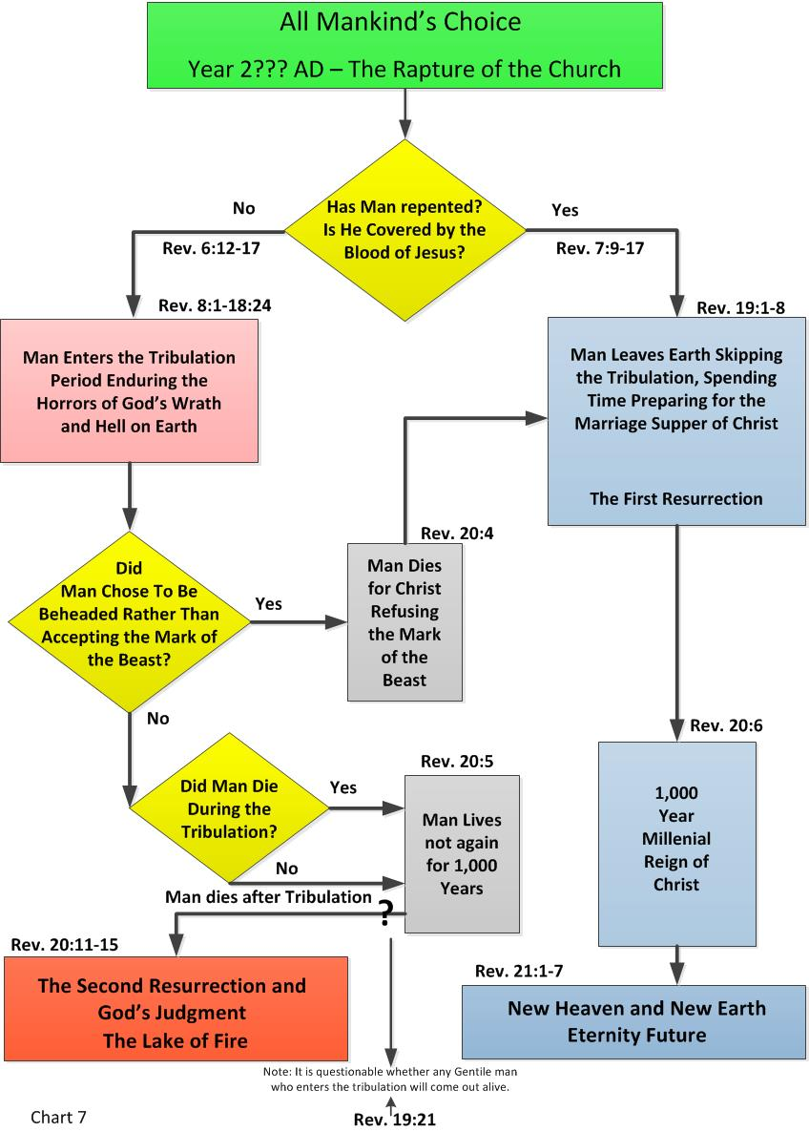
It seems that we can safely assume that we are living in the very last days before the rapture of the church. That places all mankind in the rectangular block at the top and center of the flow chart.
Copyright © 2020 by Barney Rapp
Notes:
Based on our studies thus far, it seems that we can safely assume that we are living in the very last days before the rapture of the church. That places all mankind in the green rectangular block at the top and center of the flow chart.

Slide 158
The only way out of that block is through what is called a decision block. The decision block asks a simple question and has two paths out, depending on the answer to the question. This decision block is asking about our relationship with God.
Copyright © 2020 by Barney Rapp
Notes:
The only way out of that block is through what is called a decision block. The decision block asks a simple question and has two paths out, depending on the answer to the question. This decision block is asking about our relationship with God.

Slide 159
All those who chose the left hand branch are going to enter the tribulation period and experience the wrath and judgments of almighty God and eventually will spend eternity in the lake of fire. Once this path has been chosen, the only way to save one's life and soul is to be beheaded instead of taking the mark of the beast.
Copyright © 2020 by Barney Rapp
Copyright © 2020 by Barney Rapp
Notes:
All those who chose the left hand branch are going to enter the tribulation period and experience the wrath and judgments of almighty God and eventually will spend eternity in the lake of fire. Once this path has been chosen, the only way to save one's life and soul is to be beheaded instead of taking the mark of the beast.

Slide 160
The Saints of God,
Future Judges
What we want to focus on next, is what the future holds for those who chose the right hand branch in the flow chart. The multitude we see described in Revelation chapter 7.
Copyright © 2020 by Barney Rapp
Notes:
What we want to focus on next, is what the future holds for those who chose the right hand branch in the flow chart. Those who chose the right hand branch, are part of the individuals that make up the great multitude that we saw described in Revelation chapter 7. Remember that the multitude from Rev. 7 consists of the raptured church along with all those who died believing and trusting in Christ.

Slide 161
The Roll of the Saints
The saints, the bride of Christ, will have a role to play in Christ's Millennial reign. Actually their role will be to help Christ usher in His Millennial reign. In 1 Corinthians chapter 6 verses 2 and 3, we are told that the saints will judge the world and angels. We see further proof of this in the Book of Jude where we are told that the saints will not only judge, but will also execute judgment. That doesn't just mean pronounce judgment but it means to literally execute that judgment.
Copyright © 2020 by Barney Rapp
Notes:
Read the slide.

Slide 162
The Roll of the Saints
And Enoch also, the seventh from Adam, prophesied of these, saying, Behold, the Lord cometh with ten thousands of his saints, To execute judgment upon all, and to convince all that are ungodly among them of all their ungodly deeds which they have ungodly committed, and of all their hard speeches which ungodly sinners have spoken against him.
Jude 14-15 KJV
Copyright © 2020 by Barney Rapp
Notes:
Read the scripture.

Slide 163
The Roll of the Saints
As you read the verses in Jude, some might argue that the saints will not execute the convicted, that it will be Christ who will do the executing of judgment. So let's dig a little deeper and see what else the scriptures have to say about this matter.
Copyright © 2020 by Barney Rapp
Notes:
Read the slide.

Slide 164
The Roll of the Saints
Let the saints be joyful in glory: let them sing aloud upon their beds. Let the high praises of God be in their mouth, and a twoedged sword in their hand; To execute vengeance upon the heathen, and punishments upon the people; To bind their kings with chains, and their nobles with fetters of iron; To execute upon them the judgment written: this honour have all his saints. Praise ye the Lord.
Psalms 149:5-9 KJV
Copyright © 2020 by Barney Rapp
Notes:
Read the scripture.

Slide 165
The Roll of the Saints
There is a passage of scripture in Daniel that has puzzled theologians for years. Daniel references the 1,290 days then says, blessed is anyone who comes to 1,335 days. For years now, Bible scholars have questioned the significance of these 45 days that Daniel speaks of. Are they a reference to the transition time between the time Christ returns with His saints at the battle of Armageddon and when the last of the Psalm chapter 149 judgments are carried out.
Copyright © 2020 by Barney Rapp
Notes:
Read the slide. Not definite on this, just throwing this out as something to think about.

Slide 166
The Conclusion of the Battle of Armageddon
At the conclusion of the Battle of Armageddon the false prophet, the beast, who is also called the Antichrist, and all who worshiped the image of the beast were cast alive into the lake of fire for all of eternity. The dragon who is the devil and Satan is bound a thousand years and cast into the bottomless pit. At the end of the thousand years, he will be released to once again deceive the nations for a period of time. As we look at the story of Satan's release from the bottomless pit, we see him engaging Gog and Magog to do battle with the saints of God. This battle of Gog and Magog seems like it is probably what most people today call Ezekiel's war.
Copyright © 2020 by Barney Rapp
Notes:
Read the slide.

Slide 167
The Conclusion of the Battle of Armageddon
And the beast was taken, and with him the false prophet that wrought miracles before him, with which he deceived them that had received the mark of the beast, and them that worshipped his image. These both were cast alive into a lake of fire burning with brimstone.
Revelation 19:20 KJV
And he laid hold on the dragon, that old serpent, which is the Devil, and Satan, and bound him a thousand years, And cast him into the bottomless pit, and shut him up, and set a seal upon him, that he should deceive the nations no more, till the thousand years should be fulfilled: and after that he must be loosed a little season.
Revelation 20:2-3 KJV
Copyright © 2020 by Barney Rapp
Notes:
Read the scriptures.

Slide 168
The Conclusion of the Battle of Armageddon
And when the thousand years are expired, Satan shall be loosed out of his prison, And shall go out to deceive the nations which are in the four quarters of the earth, Gog and Magog, to gather them together to battle: the number of whom is as the sand of the sea.
Revelation 20:7-8 KJV
And the devil that deceived them was cast into the lake of fire and brimstone, where the beast and the false prophet are, and shall be tormented day and night for ever and ever.
Revelation 20:10 KJV
Copyright © 2020 by Barney Rapp
Notes:
Read the scriptures. This war involving Gog and Magog is a very brief war at the end of the thousand year Millennial reign.

Slide 169
Post Millennial Reign
Following the Millennial reign, God creates the new heaven and new earth. At this time, John also sees the new Jerusalem coming down from God out of heaven. John spends nearly a whole chapter in the book of Revelation describing the new Jerusalem. This new Jerusalem is what most people are describing when they talk about what heaven will be like. the city is actually a perfect cube that measures a little more than 1,377 miles on each side and in height. That is just a few miles less than the 1,386 miles that Detroit, Michigan is from Miami, Florida.
Copyright © 2020 by Barney Rapp
Notes:
Read the slide.

Slide 170
Post Millennial Reign
As we look at the scripture, we see that God is very clear about who will be in this city and who will not. The new Jerusalem is for the bride of Christ, those who have their names written in the book of life. It is not for those who have chosen to disobey God's commands. We can see in the scriptures below where God once again innumerate's a list of behaviors that will keep one from fellowship with God.
Copyright © 2020 by Barney Rapp
Notes:
Read the slide.

Slide 171
Post Millennial Reign
But the fearful, and unbelieving, and the abominable, and murderers, and whoremongers, and sorcerers, and idolaters, and all liars, shall have their part in the lake which burneth with fire and brimstone: which is the second death.
Revelation 21:8 KJV
And there shall in no wise enter into it any thing that defileth, neither whatsoever worketh abomination, or maketh a lie: but they which are written in the Lamb's book of life.
Revelation 21:27 KJV
Copyright © 2020 by Barney Rapp
Notes:
Read the scriptures.

Slide 172
Post Millennial Reign
For without are dogs, and sorcerers, and whoremongers, and murderers, and idolaters, and whosoever loveth and maketh a lie.
Revelation 22:15 KJV
And he shewed me a pure river of water of life, clear as crystal, proceeding out of the throne of God and of the Lamb. In the midst of the street of it, and on either side of the river, was there the tree of life, which bare twelve manner of fruits, and yielded her fruit every month: and the leaves of the tree were for the healing of the nations.
Revelation 22:1-2 KJV
Copyright © 2020 by Barney Rapp
Notes:
Read the scriptures. The new Jerusalem is God's replacement for the Garden of Eden. The new Jerusalem is where God wants to Fellowship with man through all eternity.

Slide 173
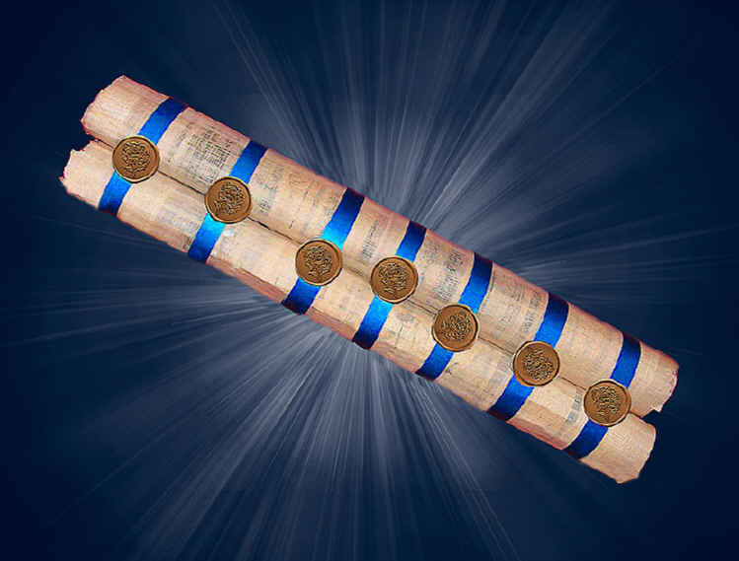
The Seven Sealed Scroll
Copyright © 2020 by Barney Rapp
Notes:
The Seven Sealed Scroll. Let’s discover what it is all about.

Slide 174
The Seven Sealed Scroll
We just saw, in the previous chapter, where God has created a new heaven and a new earth as well as the new Jerusalem. We also saw where God cast the antichrist and the false prophet into the lake of fire. And finally, we see God casting the devil into the lake of fire. So how did God deal with Satan's temporary dominion over the earth? Well, that's where the seven sealed scroll comes in.
Copyright © 2020 by Barney Rapp
Notes:
Read the slide.

Slide 175
The Seven Sealed Scroll
What the Seven Sealed Scroll Is Not
One theory is that the seven sealed scroll is the prophecies of the judgments of the tribulation period.
Copyright © 2020 by Barney Rapp
Notes:
Read the slide. This theory doesn't seem to make any sense, for the simple fact that the Book of Revelation is doing exactly that. Why would this book be duplicating the information that John is already providing us with in the book of Revelation?

Slide 176
The Seven Sealed Scroll
What the Seven Sealed Scroll Is Not
One theory is that the seven sealed scroll is the prophecies of the judgments of the tribulation period.
Another theory is that this is the Book of Life with the names of the saints written therein.
Copyright © 2020 by Barney Rapp
Notes:
Another theory is that this is the Book of Life with the names of the saints written therein. It is not the book of life. God is continually in a process of adding and removing names from the Book of Life. Also, John wouldn't call it a seven sealed book, he would call it the Book of Life like he does on seven other times in the Book of Revelation. John refers to the Book of Life both before our introduction to the seven sealed book and also after its introduction.

Slide 177
The Seven Sealed Scroll
What the Seven Sealed Scroll Is Not
One theory is that the seven sealed scroll is the prophecies of the judgments of the tribulation period.
Another theory is that this is the Book of Life with the names of the saints written therein.
Yet another theory claims that the seven sealed scroll is the Word of Salvation and contains the final purposes of God to undo the curse of sin.
Copyright © 2020 by Barney Rapp
Notes:
Yet another theory claims that the seven sealed scroll is the Word of Salvation and contains the final purposes of God to undo the curse of sin.
The curse of sin has already been dealt with through Christ's death on the cross. Nothing further needs to be done, Christ has provided our atonement, all we need to do is accept it.

Slide 178
The Law of the Kinsman Redeemer
We probably haven't exhausted all the theories that people have put forth, but let's examine what seems to be the most logical and plausible explanation that is based on both scripture, Jewish custom and Roman history. The seven sealed scroll is most likely the title deed to the earth and to all the property associated with the earth. Let's examine the Roman history, the Jewish customs and the scriptures in this respective order.
Copyright © 2020 by Barney Rapp
Notes:
Read the slide.

Slide 179
The Law of the Kinsman Redeemer
First, Roman history tells us that when a person wanted to leave a will, or a testament as they called it, they did so in the following manner. The testament was made in the presence of seven witnesses and each witness set their seal to the document or scroll to validate the will. If the document was not sealed with seven seals then the Roman court would invalidate the document. That is not too much different than how we do it today in our society where we use two witnesses as proof that a last will and testament is valid.
Copyright © 2020 by Barney Rapp
Notes:
Read the slide.

Slide 180
The Law of the Kinsman Redeemer
Second, Jewish custom tells us that when a person lost his land due to a debt, the obligations required to reclaim the land were written on two scrolls. One scroll was unsealed so that it could be read and reviewed. It was stored in a public place within the Tabernacle. The other scroll was sealed with seven seals and held by the new owner of the land or in some other secure location for safe keeping by the new owner. The land or property described in the scroll could only be reclaimed by a qualified person. A kinsman redeemer who was willing to pay the price of redemption required to break the seven seals and satisfy the judgment lien identified within the scroll.
Copyright © 2020 by Barney Rapp
Notes:
Read the slide.

Slide 181
The Law of the Kinsman Redeemer
If we look at Leviticus chapter 25 verse 23, we see where God has told His chosen people that the land is not to be sold. Not only does God say that the land is not to be sold, He goes on to say that the land belongs to Him. When Adam sinned, man lost his right of dominion over the earth and Satan assumed that dominion. We also see where God instituted the concept of the kinsman redeemer in verse 25.
Copyright © 2020 by Barney Rapp
Notes:
Read the slide.

Slide 182
The Law of the Kinsman Redeemer
The land shall not be sold for ever: for the land is mine; for ye are strangers and sojourners with me.
Leviticus 25:23 KJV
If thy brother be waxen poor, and hath sold away some of his possession, and if any of his kin come to redeem it, then shall he redeem that which his brother sold.
Leviticus 25:25 KJV
Copyright © 2020 by Barney Rapp
Notes:
Read the scriptures.

Slide 183
The Law of the Kinsman Redeemer
When we go to purchase a piece of property today, some properties are considered to be unimproved while others are improved. An unimproved property would be a piece of vacant land, while an improved property is considered to be one that has a structure of some type on it. Man was God's improvement to planet earth. If we look at Colossians chapter 1 and Hebrews chapter 9, we see where the death of God's Son paid the redemptive price for mankind's transgressions. Not only did God need to reclaim the land that was lost through sin, but God also needed to pay the price for mankind's sin through the shedding of blood.
Copyright © 2020 by Barney Rapp
Notes:
Read the slide.

Slide 184
The Law of the Kinsman Redeemer
What God really wants back is man. Man is God's prized possession. God desired man and desired to have fellowship with man, and God was willing to pay the price to reclaim man and to redeem man. According to the law of the kinsman redeemer, the new owner of the land could not keep the land if the original owner had the means to pay the price to redeem the land. In Peter, we are told that Christ died, shedding His sinless blood to redeem us from the debt of sin we are all bound to. We only need to avail ourselves of His redemption.
Copyright © 2020 by Barney Rapp
Notes:
Read the slide.

Slide 185
The Law of the Kinsman Redeemer
Forasmuch as ye know that ye were not redeemed with corruptible things, as silver and gold, from your vain conversation received by tradition from your fathers; But with the precious blood of Christ, as of a lamb without blemish and without spot:
1 Peter 1:18-19 KJV
For there is one God, and one mediator between God and men, the man Christ Jesus; Who gave himself a ransom for all, to be testified in due time.
1 Timothy 2:5-6 KJV
Copyright © 2020 by Barney Rapp
Notes:
Read the scriptures.

Slide 186
The Law of the Kinsmen Redeemer
The seven sealed book, here in Revelation, is the redemption paper for reclaiming the earth that was lost to Satan by Adam when he committed sin in the garden of Eden. God gave Adam authority over the earth and over all creatures on the earth but when Adam sinned, he relinquished that authority to Satan. So why didn't God just send an angelic being like Michael or Gabriel to redeem man?
Copyright © 2020 by Barney Rapp
Notes:
Read the slide.

Slide 187
The Law of the Kinsmen Redeemer
The answer to that is very simple. The redeemer had to be a man, the redeemer had to be a part of the human race. The law of the kinsman redeemer specified that the redeemer had to be a qualified relative. This is why John wept when initially no man was found to open the book. He knew an angel wouldn't do, the redeemer had to be a man. As we said earlier, the hope of the Christian church and even of the whole world is dependent on a kinsman redeemer being able to open this seven sealed book in order to redeem mankind.
Copyright © 2020 by Barney Rapp
Notes:
Read the slide.

Slide 188
The Law of the Kinsman Redeemer
When Christ was born of the virgin Mary, He met the condition of being a kinsman redeemer because He became a part of the human race. When Christ died a sinless death on the cross, He earned the right to redeem the earth back from Satan. Jesus earned not only the right to redeem the earth but to also redeem God's lost possession, mankind. The shedding of His innocent and worthy blood legally discharged the lien on the souls of all men.
Copyright © 2020 by Barney Rapp
Notes:
Read the slide.

Slide 189
The Law of the Kinsman Redeemer
The seven sealed book is the title deed to the earth and to man, God's improvement to the earth. The four beasts and the four and twenty elders are Christ's witnesses to His payment to reclaim that which had been lost. When Adam sinned, he lost the title deed of earth to Satan. When Christ died on the cross He earned the right to take back that title deed from Satan and the seals are now in the process of being opened.
Copyright © 2020 by Barney Rapp
Notes:
Read the slide.

Slide 190
Conclusion
We have looked at a lot of prophecies and reviewed a lot of scriptures. And while you may not agree with all our view points, the one thing that most of us do agree on is that spiritually speaking, time is short. It seems every- where you look people are noticing signs and there is a general feeling that something is about to happen. The question is, What do we do about it? That's a very good question, because if we don't ask that question it is very likely that we will simply continue on as we are and do nothing about it.
Copyright © 2020 by Barney Rapp
Notes:
Read the slide.
If we don’t do anything, where will we be?

Slide 191
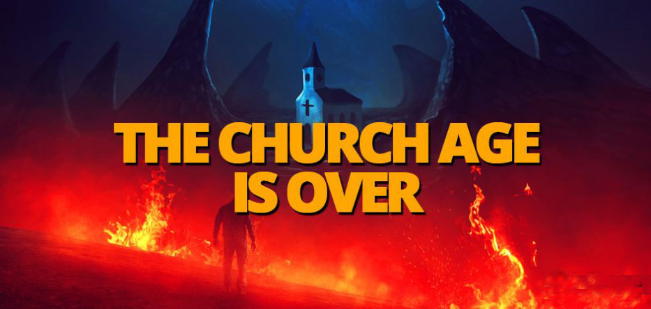
Conclusion
Copyright © 2020 by Barney Rapp
Notes:
We will find that the church age is over. But, It’s not over yet, though it soon will be! So what should we do? Take Inventory of our spiritual health.
What did Christ most warn us to watch for? DECEPTION! We need to take an honest look at the spiritual health of our society, the church and ourselves.

Slide 192
Conclusion
The hardest thing for any of us to see, is our own faults. Take an alcoholic for example. The most difficult part of an alcoholic's recovery is getting him to admit that he is an alcoholic. It seems that we as Christians aren't too much different from the alcoholic. Earlier, we identified the Laodicean church as representative of our time. And what did Christ have to say about the Laodicean church?
Copyright © 2020 by Barney Rapp
Notes:
Read the slide.

Slide 193
Conclusion
So then because thou art lukewarm, and neither cold nor hot, I will spue thee out of my mouth. Because thou sayest, I am rich, and increased with goods, and have need of nothing; and knowest not that thou art wretched, and miserable, and poor, and blind, and naked: I counsel thee to buy of me gold tried in the fire, that thou mayest be rich; and white raiment, that thou mayest be clothed, and that the shame of thy nakedness do not appear; and anoint thine eyes with eyesalve, that thou mayest see.
Rev 3:16-18 KJV
Copyright © 2020 by Barney Rapp
Notes:
Read the scripture.

Slide 194
Conclusion
Just like the alcoholic, the hardest part in getting the Laodicean church member the help he needs, is to get him to admit his need. For many, going to church is a habitual routine not a holy rite. For many, living and acting differently, out of church than in church, is an accepted norm when it should be an unacceptable exception. The point is, God wants a holy church, a people exemplifying a life that Christ Himself would live if He were walking in our shoes today.
Copyright © 2020 by Barney Rapp
Notes:
Read the slide.

Slide 195
Examining the Spiritual Health of Our Society
The Ten Commandments are a good reference point to measure not only the spiritual health of the Laodicean church in our society, but also the spiritual health of our American society in general. We see evidence of the Ten Commandments and other Judeo-Christian symbols and scriptures mingled throughout America's most prominent landmarks. Since the latter half of the twentieth century, there has been an ongoing assault to discredit America's ties to its spiritual heritage. The founding fathers intentions were to keep the state out of the church not the church out of the state.
Copyright © 2020 by Barney Rapp
Notes:
Read the slide.

Slide 196
Examining the Spiritual Health of Our Society
The founding fathers intentions were to keep the state out of the church not the church out of the state. In today's society, marriage is seen as an institution of the state. Early in the United States, some churches accepted marriage based on the statement of a man and a woman agreeing to live in a marital state. By the nineteenth century marriage licenses were common in the United States and today a church can't perform a marriage without a state license. The state is now in the process of redefining marriage and what was once the dominion the church, has become the dominion of the state.
Copyright © 2020 by Barney Rapp
Notes:
Read the slide.

Slide 197
Examining the Spiritual Health of Our Society
In colonial America, it was common for children to be home schooled or for the schools to be run by churches. At the beginning of the Twentieth Century, many classrooms started each day with the pledge of allegiance, a prayer and a scripture reading from the Bible. By the end of the Twentieth Century, prayer had been banned from the classroom and any public functions of the school, including sports and social activities. The Twentieth Century has also seen the teaching of the theory of evolution and the Biblical story of the Creation has been banned. So what we have in the Twentieth Century is a state that has made it illegal for a child not to attend school yet that student has been forbidden their right to worship or call upon their God while doing so. The same state government that was originally founded to provide freedom of religion has twisted the founders concept to mean freedom from religion.
Copyright © 2020 by Barney Rapp
Notes:
Read the slide.

Slide 198
Examining the Spiritual Health of Our Society
Let's look at the Internal Revenue Service and the 501C tax code. The first income tax was a temporary tax levied in 1862 by the Union to pay for the cost of the Civil War. In 1913 the Sixteenth Amendment to the Constitution was ratified allowing the government to collect taxes on income. Prior to 1954, churches were automatically exempt from taxation, but in 1954 Senator Lyndon B. Johnson introduced a bill that made it illegal for a church to openly speak out against anything that the government declared "legal," even if it is immoral, such as abortion or homosexuality. If a church speaks out, it jeopardizes its tax exempt status. The effect is that free speech within the church is under attack and the churches voice against sin has been stifled.
Copyright © 2020 by Barney Rapp
Notes:
Read the slide.

Slide 199
Examining the Spiritual Health of Our Society
Since colonial days, our country has had Blue Laws. A Blue Law is a law that prohibits commercial activity on Sunday. Many states and towns passed laws to forbid merchants and laborers from working on Sunday. These laws were not based on concerns that workers deserved a day of rest. Instead, they were meant to respect the Christian Sabbath and were directed at personal activities regarded as moral offenses, such as gambling or the consumption of alcohol. Prior to the twentieth century most all non-essential businesses were closed on Sunday. Only hospitals, inns for lodging and feeding guests and a few other necessary businesses were open for business.
Copyright © 2020 by Barney Rapp
Notes:
Read the slide.

Slide 200
Examining the Spiritual Health of Our Society
The Blue Laws were challenged in Court for financial reasons and it was ruled that historically the laws had a religious motivation and were designed to promote the concepts of Christian theology. The Court then ruled that the law did not infringed on an individual's religious freedom but that it only caused financial loss. The Blue Laws survived the Supreme Court but they have all but died in the face of America's moral decline. The only Blue Laws that remain are the few related to Sunday liquor sales.
Copyright © 2020 by Barney Rapp
Notes:
Read the slide.

Slide 201
Examining the Spiritual Health of Our Society
So despite the attempt to alter history, the evidence still points to the fact that America's founders intentionally worked to establish a new type of republic. A republic based on Judeo-Christian principals and morals. A republic that believed in the biblical God of Israel. A republic that believed in God's Ten Commandments and God's moral laws. A republic that derived its power from God and a republic that must answer to God morally. A republic that established freedom of religion not freedom from religion.
Copyright © 2020 by Barney Rapp
Notes:
Read the slide.

Slide 202
Examining the Spiritual Health of the Church
So exactly what are these Ten Commandments that the atheists and the anti-god group hate and fear so much? As the name implies, there are ten of them and they are commands. One might also think of them as laws, or rules or instructions. Much like how a parent might instruct a child. The Ten Commandments can easily be divided into two groups. The first four commandments deal with man's relationship to God and the last six deal with man's relationship to his fellow man.
Copyright © 2020 by Barney Rapp
Notes:
Read the slide.

Slide 203
Examining the Spiritual Health of the Church
It seems that most of America today, including many of those associated with some church body, tend to totally ignore the commandments of God. The only commandments they follow are those command- ments that have penalties attached to them according to America's civil law. One might argue that the only commandments the typical American follows are number 6, thou shalt not murder and number 8, thou shalt not steal. Then it might be questioned, are the commandments being kept or simply civil law?
Copyright © 2020 by Barney Rapp
Notes:
Read the slide.

Slide 204
Examining the Spiritual Health of the Church
When you think of the ten commandments, what is the first one that comes to your mind? Is it "thou shalt not kill (murder)"? When you give your child a list of chores or duties to be performed, how do you prioritize the list? Do you put the least important chore or duty first? No, of course not. You put the most important one first, then followed by the one you consider to be next in importance. The order of importance to your child never enters your thinking.
Copyright © 2020 by Barney Rapp
Notes:
Read the slide.

Slide 205
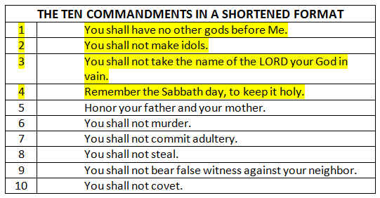
Examining the Spiritual Health of the Church
Copyright © 2020 by Barney Rapp
Notes:
So here is a simple paraphrase of the Ten Commandments. The first 4 are highlighted. They deal with man’s relationship to God. The next six deal with man’s relationship to his fellow man.
Exodus 20:1
Deuteronomy 5:6

Slide 206
Examining the Spiritual Health of the Church
We are all made in the image of God, so the way God deals with us is not much different than how we deal with our children. God gave us the commandments and listed them in the order of importance to Him. First and foremost, He commands us to have no other gods before Him, not our family, not our job, not some sports team, and not some television program or video game.
Copyright © 2020 by Barney Rapp
Notes:
Read the slide.

Slide 207
Examining the Spiritual Health of the Church
Remember the sabbath day, to keep it holy. Six days shalt thou labour, and do all thy work: But the seventh day is the sabbath of the Lord thy God: in it thou shalt not do any work, thou, nor thy son, nor thy daughter, thy manservant, nor thy maidservant, nor thy cattle, nor thy stranger that is within thy gates: For in six days the Lord made heaven and earth, the sea, and all that in them is, and rested the seventh day: wherefore the Lord blessed the sabbath day, and hallowed it.
Exodus 20:8-11 KJV
Copyright © 2020 by Barney Rapp
Notes:
Read the scripture.

Slide 208
Examining the Spiritual Health of the Church
How does our society honor the Sabbath day?
How does the church honor and remember the Sabbath day?
How do you honor and remember the Sabbath day?
In Jeremiah 17:19-27 the prophet Jeremiah tells the people of Judah God's instructions on how to honor the Sabbath day.
Copyright © 2020 by Barney Rapp
Notes:
Read the slide.

Slide 209
So what does the health of the
Laodicean church look like?
It looks like it is on life support. And what did Jesus say about it in Revelation chapter 3 verses 15 and 16? I know thy works, that thou art neither cold nor hot: I would thou wert cold or hot. So then because thou art lukewarm, and neither cold nor hot, I will spue thee out of my mouth.
The good news is, The Church Age isn’t over!
We can still reach out to God and seek His face.
Copyright © 2020 by Barney Rapp
Notes:
Read the slide.

Slide 210
The Biblical Path Back to God
What does the Bible have to say about backsliding and returning to God? In the Book of Jeremiah, we see the prophet Jeremiah warning Judah and the people of Israel of God's coming judgment against the nation. After the death of King Josiah, the last righteous king for the nation of Judah, we see King Nebuchadnezzar conquering Judah and the people of Israel were taken into Babylonian captivity. So how did the people go about returning to God and seeking His mercies once again?
Copyright © 2020 by Barney Rapp
Notes:
Read the slide.

Slide 211
The Biblical Path Back to God
In Nehemiah chapter 9 verses 1 and 2 we see where the children of Israel took their first step back toward God by fasting and confessing the sins and iniquities of their fathers.
Copyright © 2020 by Barney Rapp
Notes:
Read the slide.

Slide 212
The Biblical Path Back to God
In Nehemiah chapter 9 verses 1 and 2 we see where the children of Israel took their first step back toward God by fasting and confessing the sins and iniquities of their fathers.
The second step in Israel's journey back to God is found in Nehemiah chapter 9 verse 3 where we are told that the people read the Book of the Law one fourth part of the day. We are also told that the people spent another one fourth part of the day confessing their sins and worshiping the Lord their God.
Copyright © 2020 by Barney Rapp
Notes:
The second step in Israel's journey back to God is found in Nehemiah chapter 9 verse 3 where we are told that the people read the Book of the Law one fourth part of the day. We are also told that the people spent another one fourth part of the day confessing their sins and worshiping the Lord their God.

Slide 213
The Biblical Path Back to God
The third step back to God involved action on the part of the people. In Nehemiah chapter 9 verse 38 and chapter 10 verses 28 through 32 the people made a covenant to keep the law as given by Moses and to live in a certain manner (see Nehemiah chapter 9 verses 13 and 14).
Copyright © 2020 by Barney Rapp
Notes:
Read the slide.
( Note: Nehemiah 9:13-14 referenced the giving of the law to Moses by God. )

Slide 214
The Biblical Path Back to God
For many years America has enjoyed God's blessings of being God's chosen nation among the Gentiles. Our path back to God lies in our reading and studying God's Word and then confessing the sins of the nation and praising and worshiping God. America needs to get back to the basics, the ten laws given to Moses by God, The Ten Commandments. Our path back to God will require of us that we read God's Word, and reading it means to study it and to hide it in our hearts, not just reading the words, while our mind is thinking about something else.
Copyright © 2020 by Barney Rapp
Notes:
Read the slide.

Slide 215
The Biblical Path Back to God
Second, we will need to spend time in prayer and seek God's face, giving Him praise and worshiping Him. We need to make Him first and foremost in our life.
Copyright © 2020 by Barney Rapp
Notes:
Read the slide.

Slide 216
The Biblical Path Back to God
Third, we should begin confessing the sins of the nation. We need to be specific and ask God to forgive us for placing other gods before Him. We need to confess the sin of setting up idols. We need to confess the sin of taking God's name in vain, and this doesn't mean just cursing, but it means claiming to be a Christian when we live like the devil. We need to confess our sin of failing to remember the Sabbath day. We need to confess our sin of murdering millions of our unborn youth.
Copyright © 2020 by Barney Rapp
Notes:
Read the slide.

Slide 217
The Biblical Path Back to God
This is God's scriptural example of how we as
a nation, and a church, can return to Him.
The Church Age isn’t over yet!
We can do it.
But Time is short , we need to do it NOW!
Copyright © 2020 by Barney Rapp
Notes:
Read the slide.

Slide 218
Thank you so much for attending this Bible Study on the Book of Revelation.
I sincerely hope you enjoyed it and that you will share it with your friends.
Maranatha!
Notes:
Read the slide.

Slide 219
Notes:
If you would like to learn more about Revelations time line we would like to invite you to get a copy of “The Three Woes”. Not only will you learn more about Revelations time lines and the three woes, you will also learn about the significance of the Cosmic Signs, the timing of Ezekiel’s War, the fulfillment of God’s Prophetic Feast Days, and what the Seven Sealed Book of Revelation is all about. Read a chapter a day for daily devotions or use it as a study guide for a Sunday School Class or a Bible Study. “The Three Woes” is available online only, it is not currently in retail bookstores, you can get it through Amazon, Barnes and Noble or Books-A-Million. Also, visit us at our WEB site www.3woes.com and on Facebook: 3woes

